Slide 1
City of Lemoore: A Homeowner’s How-to Guide to Accessory Dwelling Units
ADU
City of Lemoore
711 W. Cinnamon Drive
Lemoore, CA 93245
(559) 924-6744
https://Lemoore.com
Last Updated June 2024

Slide 2
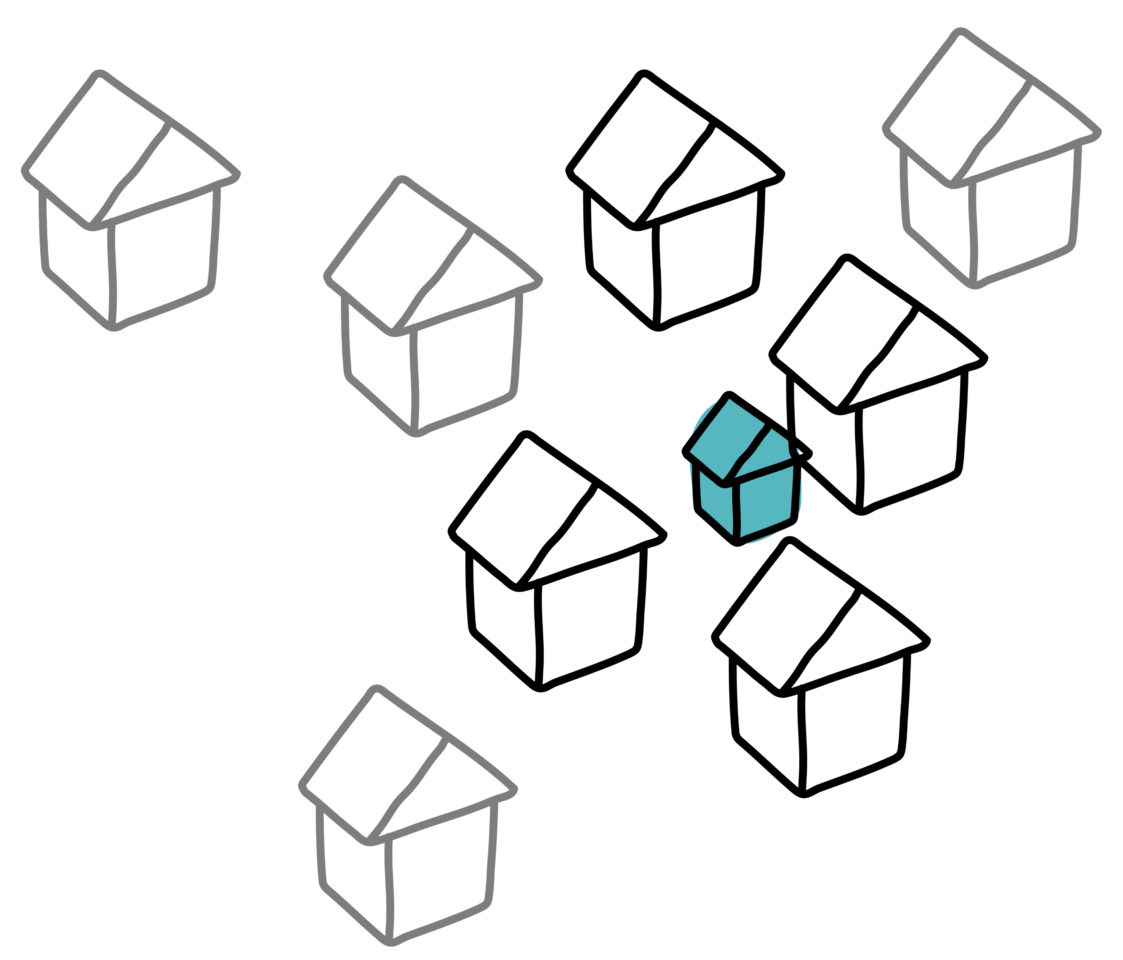
TOC
TABLE OF CONTENTS
SECTION 1. INTRODUCTION
How to Use the Guide
SECTION 2. ADU BASICS
What is an ADU?
ADU Types
SECTION 3. HOW TO BUILD AND ADU IN THE CITY OF LEMOORE
ADU Process Overview
Step 1. Determine if Your Property is Eligible for an ADU
Step 2. Review Minimum ADU Requirements
Step 3. Design Your ADU
Step 4. Prepare and Submit Your ADU Permit Application
SECTION 4. PRE-REVIEWED ADU PROGRAM
Benefits of Participating in the Program
How It Works
Floor Plans
Elevations
SECTION 5. RESOURCES, CONTACTS AND FURTHER READING
Frequently Asked Questions
Resources, Contacts, and Further Reading
1
1
2
2
2
3
3
4
5
5
7
11
11
11
12
16
22
22
22
TABLE OF CONTENTS

Slide 3
1.
SECTION 1.
INTRODUCTION
Recent changes to State Law have made it easier to construct Accessory Dwelling Units (“ADUs”) throughout the state. In response to these changes, the City of Lemoore updated its ADU Ordinance in 2024, establishing ADU standards specific to the City. To further streamline the production of ADUs, the City has established the City of Lemoore Pre-Reviewed ADU Program, offering Pre-Reviewed, “off the shelf” ADU plan sets to reduce the cost and timeframe for the ADU design and permitting process. The City has created this Homeowner’s How-to-Guide to Accessory Dwelling Units (“Guide”) to further assist property owners in the City through the process to build an ADU.
- - - - - HOW TO USE THIS GUIDE - - - - -
This Guide was created as a resource for property owners to utilize, offering information and guidance on ADU basics, regulations, design, and permitting. This Guide includes five sections:
Section 1 – Introduction (current section) provides an overview of the guide and ADUs.
Section 2 – ADU Basics provides the definition and overview of the ADUs types.
Section 3 – How to Build an ADU in the City of Lemoore provides the step-by-step process for property owners to design, submit, and build an ADU in compliance with the City’s regulations and procedures.
Section 4 – Pre-approved ADU Program gives an overview of the City of Lemoore program.
Section 5 – Resources, Contacts, and Further Reading provides answers to frequently asked questions and links to more information related to ADU.
PAGE 1

Slide 4
2.
SECTION 2.
ADU BASICS
- - - - - WHAT IS AN ADU? - - - - -
At the most basic level, an ADU is defined as a secondary housing unit on a lot that contains an existing or proposed single family residence or multi-family residential development (e.g., duplex, triplex, or apartment building) and provides complete independent living facilities including kitchen and bathroom facilities for at least one person. . Under ADU law, it is considered an “accessory” use or structure to the primary use or structure on the lot (i.e., single-family or multifamily dwellings, or mixed-use structures/uses).
- - - - - ADU TYPES - - - - -
ADUs are also known as second units, guest cottages, in-law suites, and casitas, among other terms and can be in the following forms:
ATTACHED ADU
shares at least one wall with the primary home
DETACHED ADU
free-standing structure separated from the primary home
ADU CONVERSION
conversion of existing, internal space into an ADU such as an attached or detached garage, accessory structure, or attic space
JUNIOR ADU
contained entirely within the primary home and up to 500 square feet in size
PAGE 2

Slide 5
3.
SECTION 3.
HOW TO BUILD AN ADU IN THE CITY OF LEMOORE
If your property has an existing or proposed single-family home or multi-family development (e.g., duplex, triplex, apartment building), then you may be eligible to build an ADU on your property. The following is a general overview of the steps you can expect to take as you develop your ADU; details for each step are provided on the following pages.
- - - - - ADU PROCESS OVERVIEW - - - - -
Step 1. Determine if Your Property is Eligible for an ADU
The first step is to determine if your property is eligible for an ADU. ADUs are allowed on parcels in the City that are zoned residential or are within a zone district that allow residential uses or mixed-use development and contain an existing or proposed single-family home or multi-family development.
Step 2. Review Minimum ADU Requirements
Your property and ADU concept must meet the ADU requirements according to the City’s ADU Ordinance to be approved for construction. Before designing the ADU and applying for your permit, review the minimum ADU requirements on Page 6 to see the size, height, location, and shape that your ADU can be.
Step 3. Design Your ADU
There are 4 typical ways to design your ADU: 1) hire an experienced designer, architect, or engineer to design your ADU, 2) purchase a modular or prefabricated ADU, 3) hire a design/build firm, or 4) participate in the voluntary and optional City of Lemoore Pre-Reviewed ADU Program which offers free Pre-Reviewed building plans for detached ADUs (See Pages 11-21).
Step 4. Prepare and Submit Your ADU Building Permit Application
Application Requirements for your ADU are outlined on Pages 8-10 of this Guide. Once you submit a complete and accurate application package and pay the fees, your application will be reviewed for completeness, accepted, routed, and reviewed by the City of Lemoore. Building permits will be issued upon approval and then inspections can be scheduled prior to occupancy.
1
2
3
4
PAGE 3

Slide 6
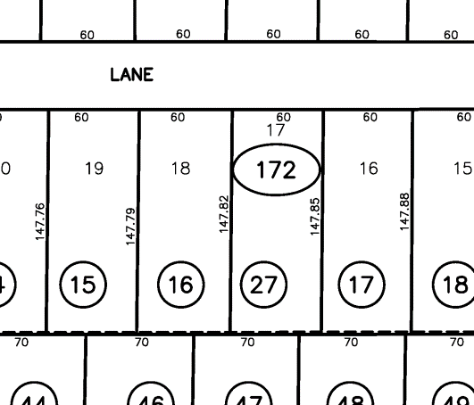
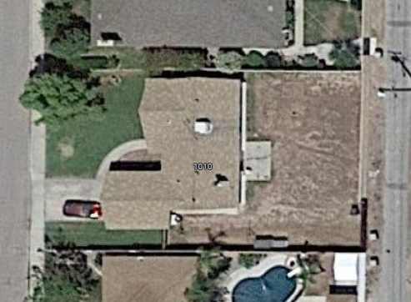
- - - - - STEP 1. DETERMINE IF YOUR PROPERTY IS ELIGIBLE FOR AN ADU - - - - -
ADUs are allowed on parcels in the City that are zoned residential or are within a zone district that allow residential uses and contain an existing or proposed single-family home or multi-family development. Refer to Lemoore’s Zoning Map to locate your property and determine your property’s zone district.
For assistance and official determination of whether your property is eligible, contact the City of Lemoore Planning Division at (559) 924-6744, ext. 740.
Identify Any Site Constraints
Before proceeding any further, locate and confirm information about your property to refine your ADU concept. Refer to the City of Lemoore’s Sample Site Plan to plot your property as it exists today and to identify the size and location of your ADU concept.
Determine the size and dimensions of your property:
Using the Kings County Parcel Maps, Assessor’s Map Page Search to view the Assessor Map image for your property. Locate your property on the Assessor Map Page and make note of the dimensions (e.g., 50 feet by 100 feet, 25 feet by 150 feet). Another option is to identify permanent structures on your property (e.g., primary dwelling, detached garage or shed, etc.) and make note of the dimensions including height and distance to property lines.
DETERMINATION EXAMPLE: APN 020-172-016
1. Enter your property’s APN or Address and click Search
2. Open the Parcel Map and
Find your lot
3. Measure dimensions to property lines and existing structures, trees, etc.
Lot Dimension:
60 feet by 147.82 feet
Property Line
PAGE 4

Slide 7
Identify any easements or special requirements:
Review a recent Title Report to identify any easements or special requirements for your property. For example, your property might have a utility easement or might grant access to an adjoining property through an access easement. In general, easements limit the buildable area on your property and their location should be noted as you start to identify the location of your ADU.
Be sure to discuss your property and project with City staff to identify any other constraints and avoid any surprises that may impact your ADU concept.
- - - - - STEP 2. REVIEW MINIMUM ADU REQUIREMENTS - - - - -
If your property is eligible for an ADU, the next step is to determine the type, number, size, height, and distance from property lines based on the City of Lemoore’s minimum ADU requirements. These minimum requirements are contained in the City of Lemoore Code of Ordinances Chapter 9-4D-12.
The Minimum Requirements Checklist provided on the next page is not intended to substitute the ADU Ordinance. Please refer to the ADU Ordinance for more information or contact the City of Lemoore Planning Division at (559) 924-6744, ext. 740 for assistance and official determination.
- - - - - STEP 3. DESIGN YOUR ADU - - - - -
There are at least four ways to design your ADU. Be sure to continue to refer to the City’s Zoning Ordinance and consult with City Staff to ensure compliance throughout the design process. Contact the City of Lemoore Planning Division at (559) 924-6744, ext. 740 for further assistance.
Design Option | Description
Participate in the City of Lemoore Pre-Reviewed ADU Program | Select from a set of plans for a detached ADU that have been pre-reviewed and approved by the City. Save on design costs. Learn more about the City’s Pre-Reviewed ADU Program on Pages 11-21.
Modular or Prefabricated Home Company | Work with a modular or prefabricated home company. Some companies may handle the entire planning and design process through construction.
Hire a Designer, Architect, or Engineer | Hire an experienced designer, architect, or engineer to design your ADU and then a builder/contractor to ultimately construct the unit.
Hire a Design/Build Firm | Hire a design/build firm to handle the entire project, from design to construction.
PAGE 5

Slide 8
Minimum Requirements for Development Standards by ADU Type
Refer to Lemoore Code of Ordinances Chapter 9-4D-12 for all standards and requirements
Standards | ADU (including Cottage Home) |  | JADU | Tiny Home
 | Attached | Detached
Number (Max.) | Single-family lots: 1 attached or detached ADU Multi-family lots: 2 detached ADUs/If attached, up to 25% existing multi-family dwelling units |  | Single-family lots: One, plus one ADU Multi-family lots: None | Single-family lots: See ADU Multi-family lots: None
Unit Size | At least 220 sqft.; Up to 50% existing primary dwelling, or 1,200 sqft., whichever is greater | At least 220 sqft.; Up to 1,200 sqft. | At least 220 sqft; Up to 500 sqft. | The first floor shall be at least 100 sqft.
Setbacks (Min.) | Following main dwelling setbacks | Front Yard: 15 ft. min. Side Yard: 4 ft. min. Rear Yard: 4 ft. min | Per main dwelling setback requirements | Front Yard: 15 ft. min. Side Yard: 4 ft. min. Rear Yard: 4 ft. min
Height (Max.) | Per main dwelling height requirements | 16 ft | Per main dwelling height requirements | 14 ft.
Parking (Max.) | 1 space per unit – see ADU ordinance for exceptions |  | None required
PAGE 6

Slide 9
- - - - - STEP 4. PREPARE AND SUBMIT YOUR ADU PERMIT APPLICATION - - - - -
The last step is to prepare and submit your ADU building permit application. Application requirements are outlined on Page 8-10 of this Guide. Once you submit a complete and accurate application package and pay the fees, your application will be reviewed for completeness, accepted, routed, and reviewed by the City of Lemoore. Building permits will be issued upon approval and then inspections can be scheduled post-construction.
Permitting Process
All ADUs require a building permit and are subject to all the standard application and permitting fees and procedures that generally apply to building permits. Depending on your situation, additional permits, studies, and reports may be required, e.g., demolition, fire sprinklers, solar panels, soils investigation, etc.
Submit plans and pay all applicable fees (See Submittal Requirements on Page 8-10). The City will review the submittal for completeness and once deemed complete, the application will be officially “accepted” for processing.
All projects will be routed to the Building Division and Planning Division.
The City will review the accepted submittal for compliance with the building, fire, and municipal code including the ADU Ordinance. Plan revisions may be necessary until deemed compliant.
PLAN REVIEW TIMELINES
Allow a minimum of 10 business days for the first plan review and five business days for all other subsequent reviews. The plan review time may be extended depending on the complexity and size of the structure.
Once deemed compliant, the plans will be approved and returned to you with a stamp of approval from the building department and you may proceed with construction.
After the ADU is constructed, final inspections will occur. Occupancy of the ADU can begin once inspections are signed off.
In general, if there is an existing single-family home or multi-family development on the property, complete applications will be acted on within 60 days or deemed approved. Exceptions to this timeline are described in the Lemoore Code of Ordinances Chapter 9-4D-12.
Submittal Requirements
Prepare and submit all items indicated and described in the Submittal Checklist on the next page.
PAGE 7

Slide 10
Submittal Checklist
Note: Submittal items denoted with a “1” indicate items provided at no-cost
with the Pre-Reviewed ADU Program.
Completed Building Permit Application.
For New Residential Construction, two (2) complete sets of plans, drawn to scale. Depending on scope or complexity of project, plans may be required to be reviewed and stamped by an architect or engineer. Plans shall include the following where applicable:
Site and Grading Plan
Landscape plan and Irrigation plan (MWELO)
Foundation Plan
Floor Plan¹
Roof and Floor Framing Plan¹
Include Solar Ready Panel
Exterior and Interior Elevations¹
Electrical Plan
Mechanical Plan and Duct Calculations¹
Plumbing Plan (Hot & Cold Water, Gas)¹
Sections¹
Details¹
Accessibility Drawings and Details (if applicable)
2 Sets of Structural Calculations (if required)
2 sets of Title 24 Calculations
2 Set of Truss Engineering
One 8 1/2” x 11” Reduced Floor Plan (Kings County Copy)¹
3 Sets of Grading Plans (Public Works)
2 Sets of Soils Reports & Compaction Tests
Waste Management Plan
Storm Water Management Plan
Encroachment Permit from Public Works
Payment of application fees and permit fees. Building Permit Fees are separate from Building Application Fees. Permit Fees are calculated at the time of permit issuance.
PAGE 8

Slide 11
Permit Fees
Refer to the City of Lemoore Master Fee Schedule for how to estimate fees. If your ADU requires fire sprinklers, solar, or demolition, then additional requirements and fees may be applicable. Contact the City of Lemoore Building Division at (559) 924-6744, ext. 730 for further assistance and official determination.
Impact Fees
Impact fees are typically required for new developments to provide new or expanded public services to the development. Depending on the size of the ADU proposed, impact fees may be waived or reduced. Impact fees are due prior to issuance of certificates of occupancy.
Size of ADU | Impact Fee Requirement
ADU less than 750 square feet | No City impact fees
ADU more than 750 square feet | City impact fees may be required and are to be charged proportionately in relation to the square footage of the primary dwelling
Connection Fees or Capacity Charges
Depending on the type of ADU proposed, new or separate utility connections may be required including water, sewer, gas, and electricity, which can add connection fees or capacity charges.
ADU Type | Connection & Fees Required
ADU constructed at the same time as a primary dwelling | A separate utility connection between the ADU and the utility, and payment of the connection fee and capacity charge for a new dwelling is required
ADU or JADU on a lot with a proposed or existing single-family dwelling, where the ADU or JADU is contained within the space of the single-family dwelling | No separate utility connection or payment of a connection fee or capacity charge is required
All other ADU types | A new, separate utility connection between the ADU and the utility, and payment of the connection fee and capacity charge at a “reasonable cost” is required
PAGE 9

Slide 12
Miscellaneous Reports, Documents, and Fees
Other miscellaneous reports and documents may be required, based on the ADU concept and site characteristics.
Miscellaneous Reports | Requirements and Fees
Roof Framing Plan/Truss Calculations | If truss-roof-layout, obtain the services of a Truss Manufacturer for truss layout plan (search for “roof truss manufacturers” online or use the Structural Building Components Association member directory). If engineered trusses are used, provide Truss Calculations.
Foundation and Soils Investigation | A foundation and soils investigation may be required per CBC Chapter 18. Additional fees may be required.
Energy Calculations and Forms (Title 24) | State law requires every new residential construction, alteration, and addition to meet the latest California Title 24 Building Energy Efficiency Standards. To demonstrate compliance, a Building Permit Application for an ADU is required to include a California Code of Regulations (CCR) Energy Analysis or Energy Compliance Report or “CF1R” that shows how your ADU will comply with Title 24. This requires you to hire a certified third-party consultant to complete the calculations and produce a report. The consultant will need the ADU plan set to be able to complete their work and fees will vary based on the consultant or company.
Fire Sprinkler System | Fire Sprinklers are required to be installed in an ADU if they are installed in the primary dwelling. If Fire Sprinklers are required, then plans are required to be submitted prior to issuance of a building permit. Additional permitting fees may be required. Review the City of Lemoore Code of Ordinances for details.
Photovoltaic (“Solar”) Permits | Solar panels may be required for newly-built ADUs in compliance with the latest California Title 24 Building Energy Efficiency Standards. Additional permitting fees may be required. Review the City of Lemoore Code of Ordinances for details.
Demolition Permit | If demolition of an existing structure is required in order to build your ADU, then a Demolition Permit Application and required documentation are required to be submitted. Additional permitting fees may be required. Review the City of Lemoore Code of Ordinances for details.
PAGE 10

Slide 13
4.
SECTION 4.
PRE-REVIEWED ADU PROGRAM
The City of Lemoore Pre-Reviewed ADU Program (“Program”) is an optional and voluntary program that provides plan sets for new construction detached ADUs that have been pre-reviewed by the City of Lemoore. The plan sets are provided at no cost to the participant, helping reduce design costs and the overall time it takes to receive building permit approval. Read on to learn more about the Program.
- - - - - BENEFITS OF PARTICIPATING IN THE PROGRAM - - - - -
Save on design costs - save costs on architectural/ design services, structural engineering services, plan review fees.
Enjoy a streamlined permitting process - plans are already reviewed and approved.
Don't sweat the details - plans already meet the zoning and building code requirements.
- - - - - HOW IT WORKS - - - - -
1. Choose Your ADU Layout & Style
The Program offers free plan sets for new construction detached ADUs that have been pre-reviewed by the City of Lemoore. The plans are offered in four sizes and four designs. The floor plans and elevations for each option are shown on the following pages.
To make sure that the ADU size would work on your property, refer to the City of Lemoore Sample Site Plan to plot your property as it exists today and measure out the minimum requirements for setbacks. Don’t forget to account for any site constraints (Page 6). Contact the City of Lemoore Planning Division at (559) 924-6744, ext. 730 for assistance and official determination.
2. Prepare Your Building Permit Application Package
Refer to the Application Process, Submittal Requirements, and Fees and Additional Requirements outlined on Pages 7-11. Program components and the responsibility of the property owner/applicant are summarized below. Contact the City of Lemoore Building Division at (559) 924-6744 for further assistance and official determination.
Required Plans/Reports Provided in Program |  | Responsibility of Property Owner/Applicant
Coversheets Floorplan Cross Sections Elevations Foundation Plan Roof Framing Plan | Structural Details Electrical Plan Plumbing Plan CALGREEN Forms (blank) | Building Permit Application Plot Plan Truss Calculations Title 24/Energy Analysis Application and Permit Fees Impact Fees (if required) Other miscellaneous reports, document, fees as required (e.g. demolition permits)
PAGE 11

Slide 14
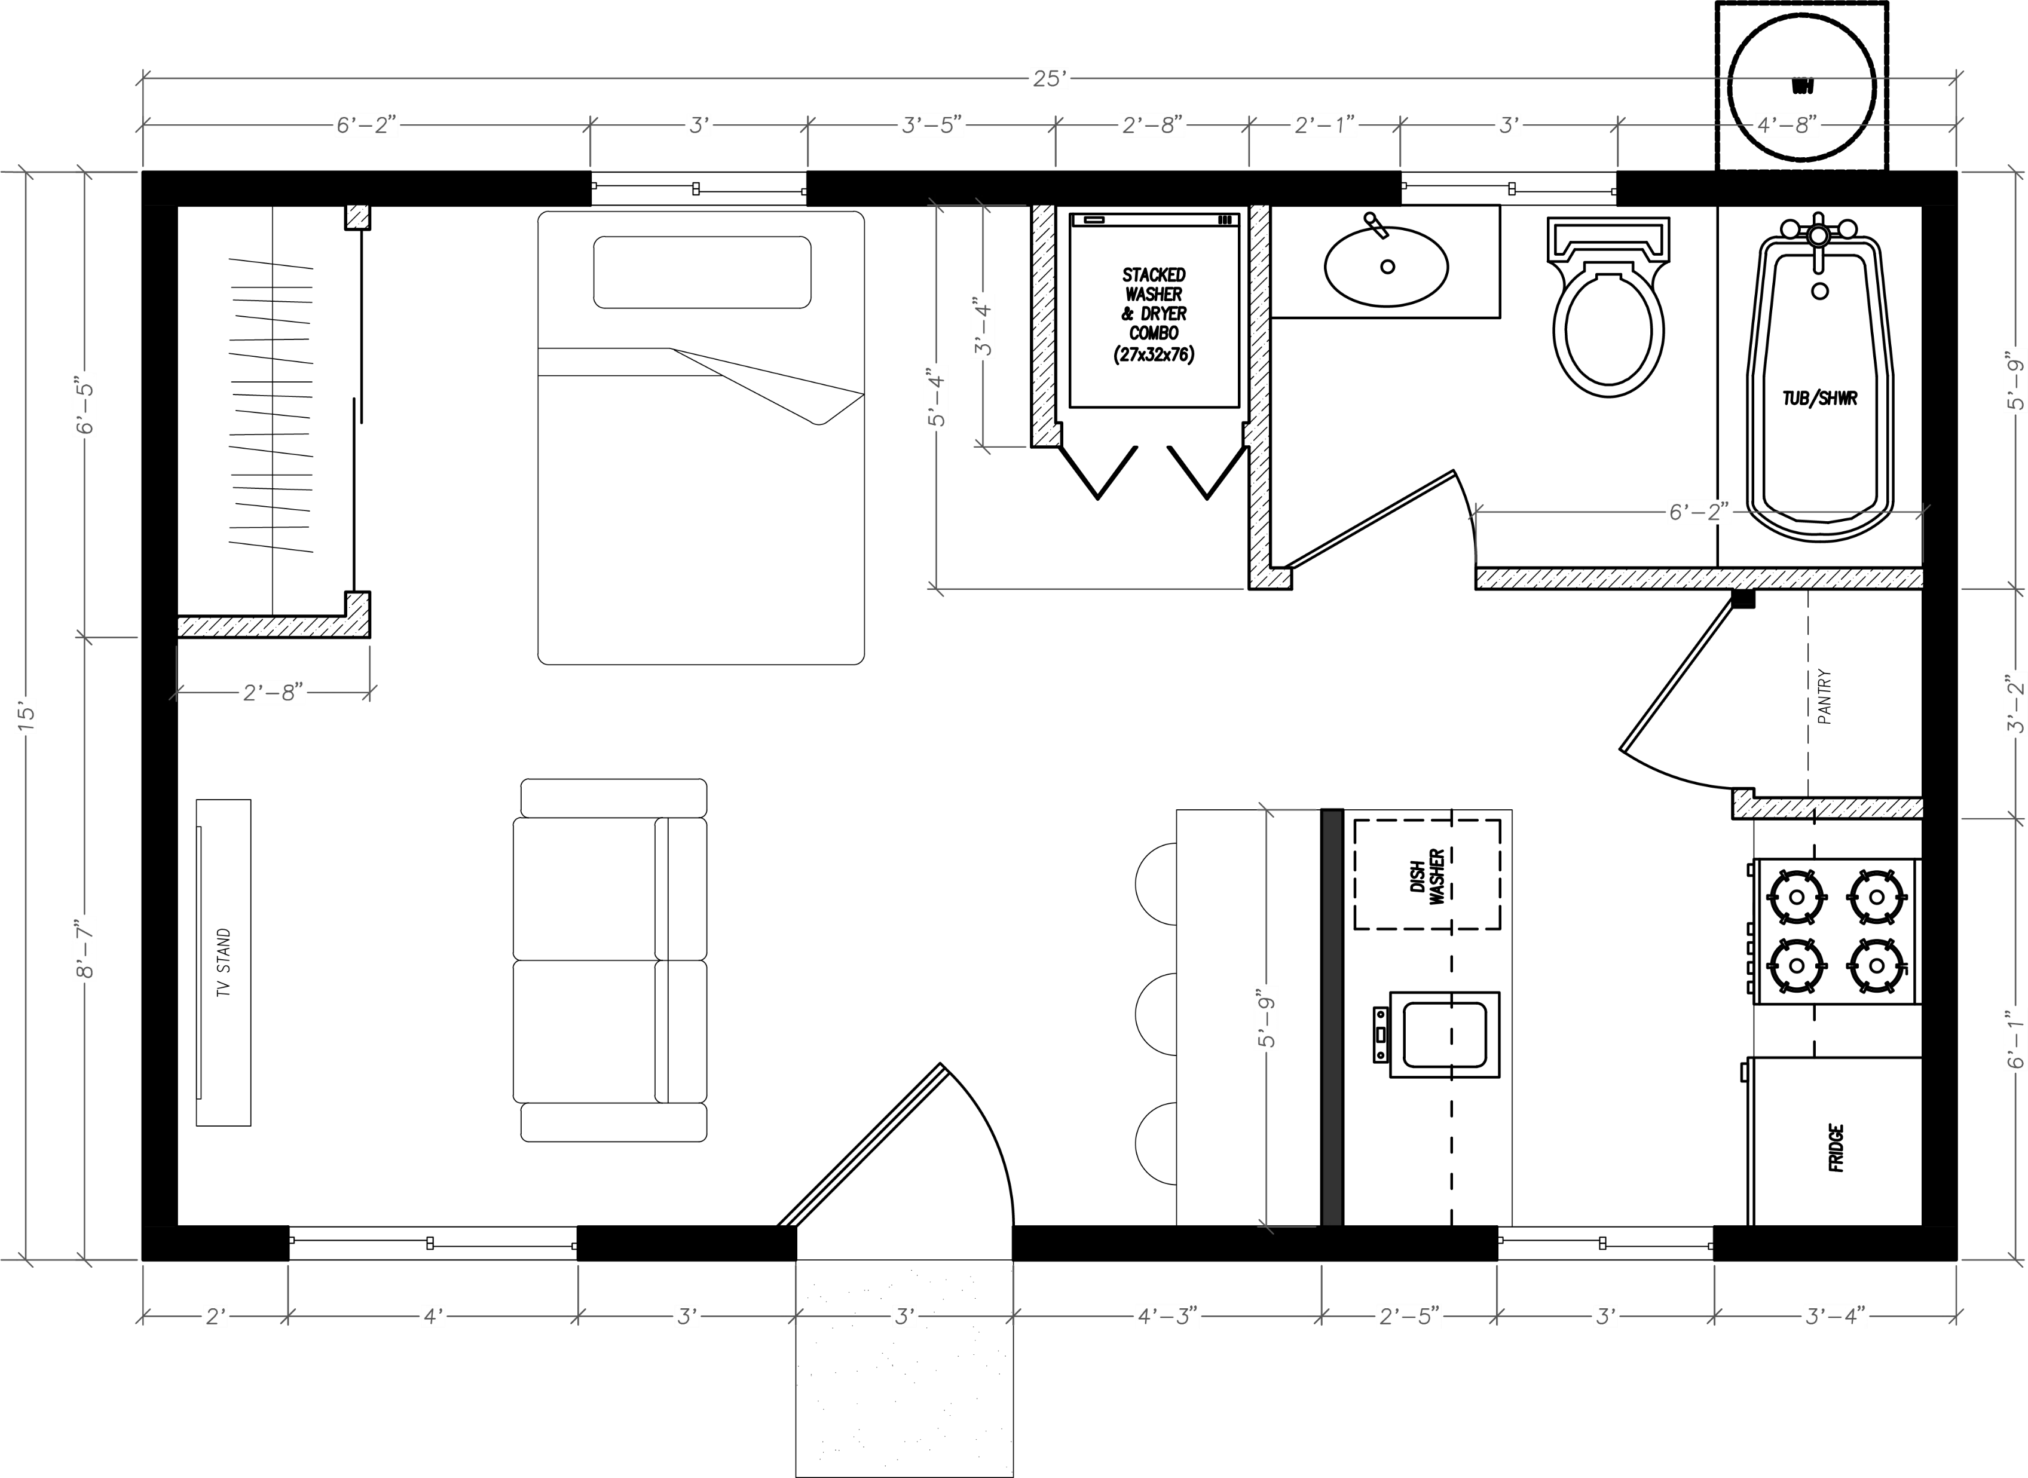
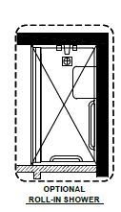
- - - - - FLOOR PLANS - - - - -
FLOOR PLAN 1
375 SQUARE FOOT FLOOR PLAN – STUDIO / 1 BATHROOM
BEDROOM
BATHROOM
LIVING ROOM
KITCHEN
DETAILS
One bathroom
Kitchen with pantry closet
Washer and dryer closet (stacked)
Dining Bar
Living Room
Bathroom with shower/tub combination
PAGE 12

Slide 15
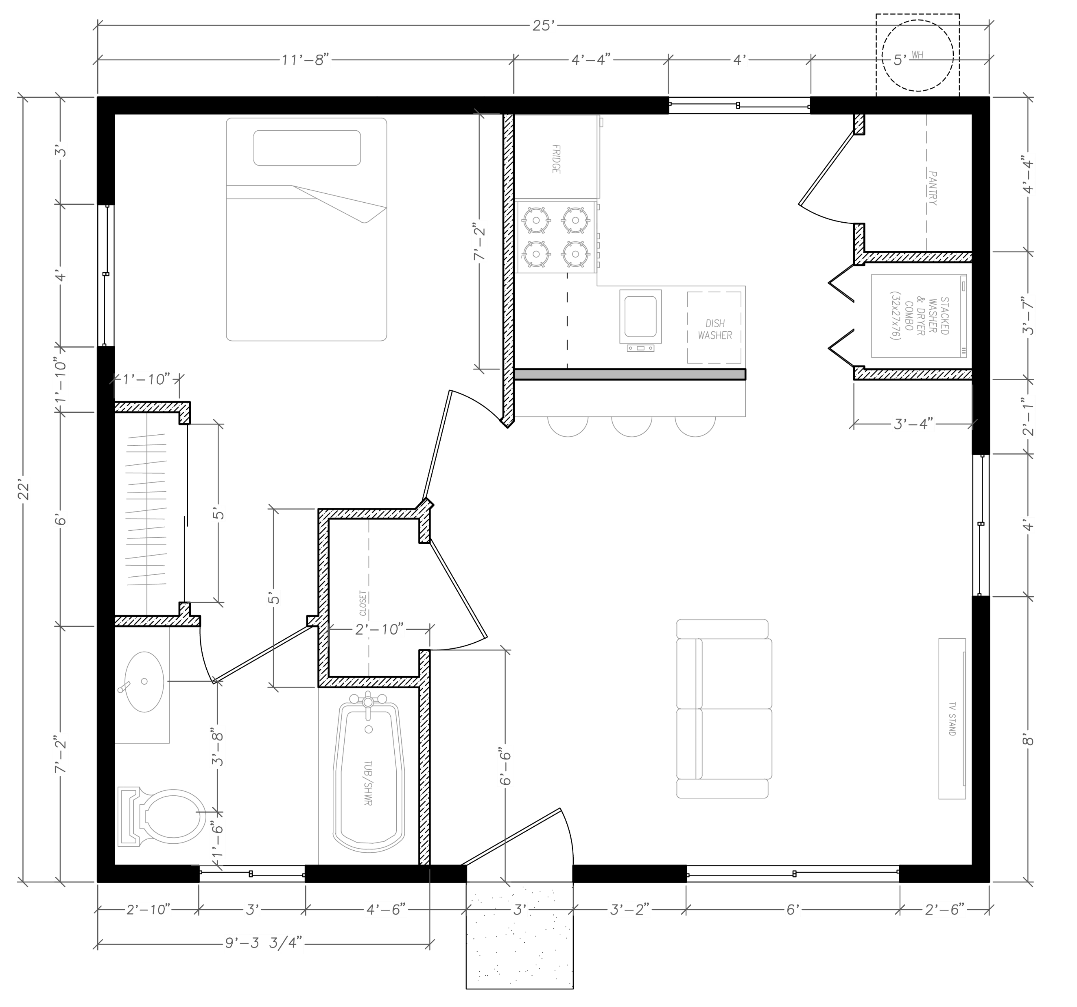
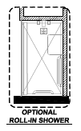
FLOOR PLAN 2
550 SQUARE FOOT FLOOR PLAN – 1 BEDROOM / 1 BATHROOM
KITCHEN
BEDROOM
LIVING ROOM
BATHROOM
DETAILS
One bedroom
One bathroom
Kitchen with pantry closet
Washer and dryer closet (stacked)
Dining Bar
Living Room
Bathroom with shower/tub
combination
PAGE 13

Slide 16
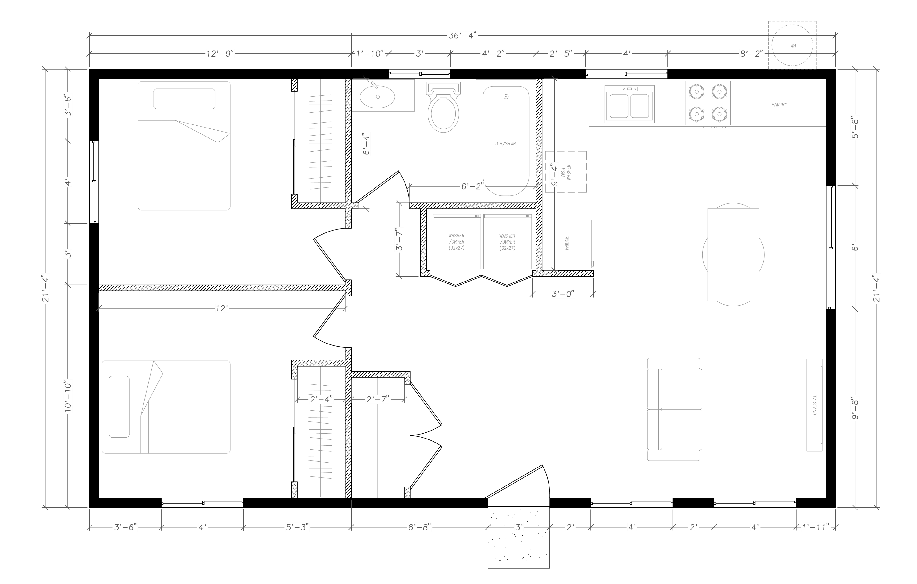
FLOOR PLAN 3
743 SQUARE FOOT FLOOR PLAN – 2 BEDROOMS / 1 BATHROOM
BATHROOM
BEDROOM
KITCHEN
BEDROOM
LIVING ROOM
DETAILS
Two bedrooms
One bathroom
Kitchen with pantry closet
Washer and dryer closet (side-by-side)
Dining Room
Living Room
Bathroom with shower/tub combination
PAGE 14

Slide 17
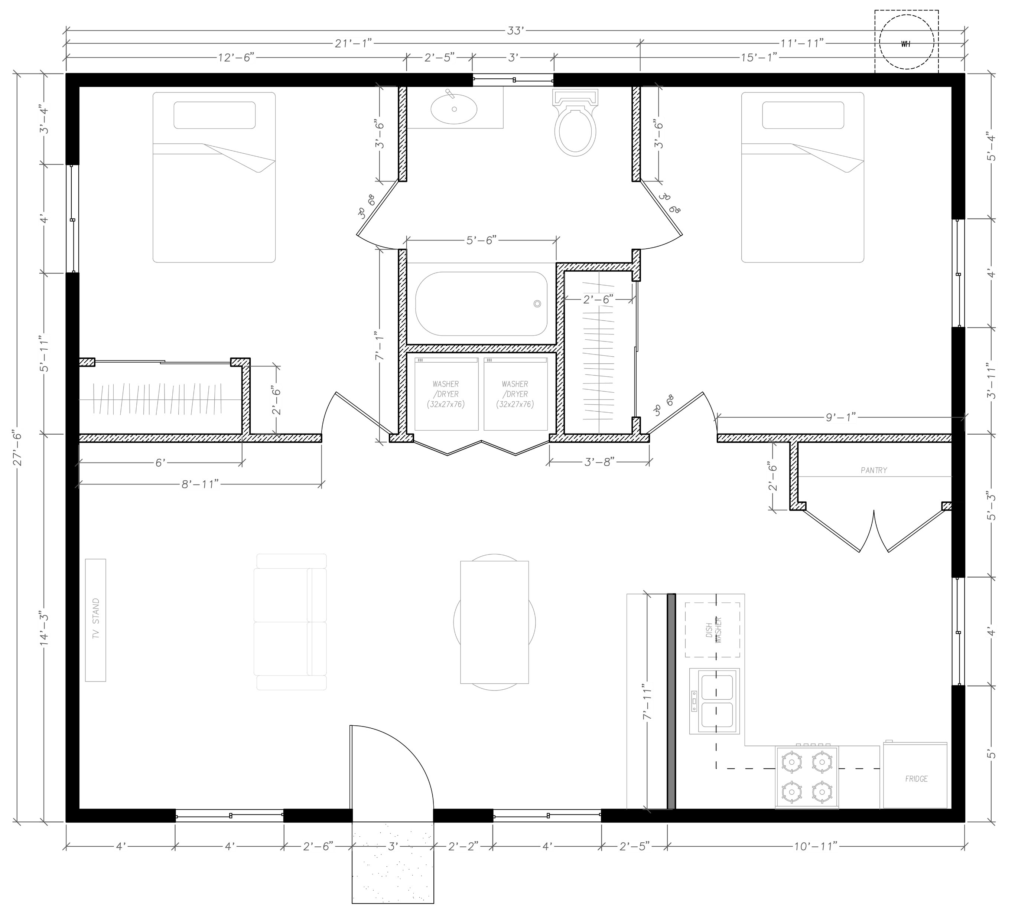
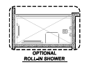
FLOOR PLAN 4
908 SQUARE FOOT FLOOR PLAN – 2 BEDROOMS / 1 BATHROOM
BATHROOM
BEDROOM
BEDROOM
LIVING ROOM
DINING
ROOM
KITCHEN
DETAILS
Two bedrooms
One bathroom
Kitchen with pantry closet
Washer and dryer closet (side-by-side)
Dining Room
Living Room
Bathroom with shower/tub combination
PAGE 15

Slide 18
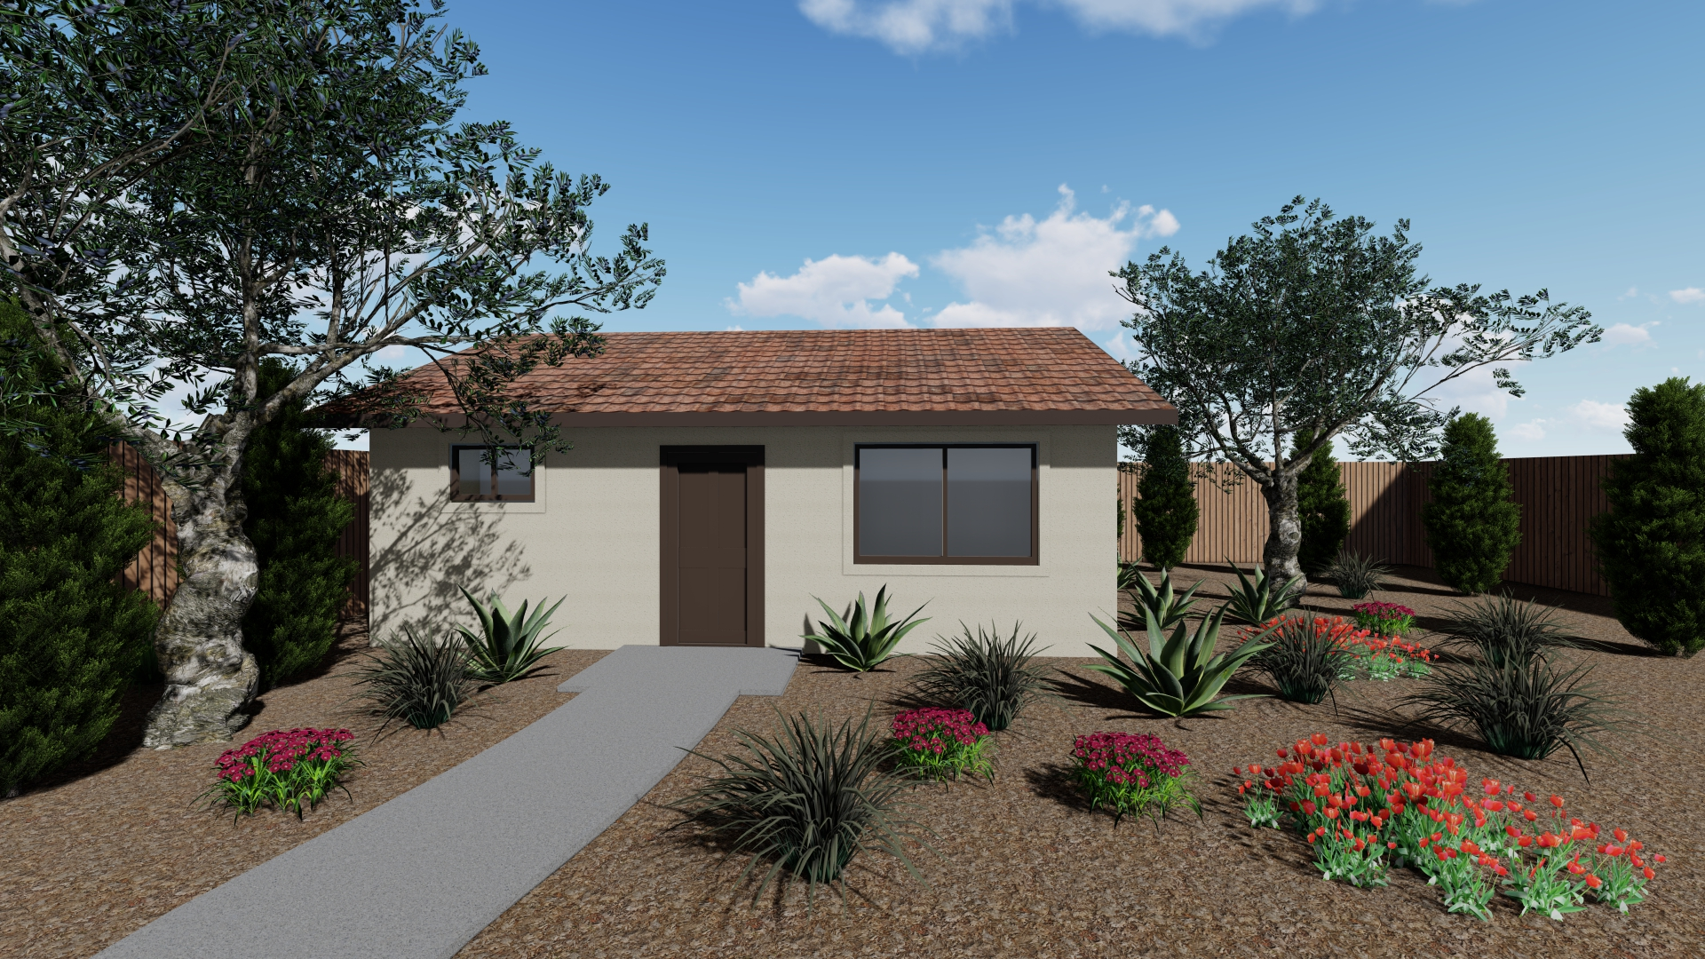
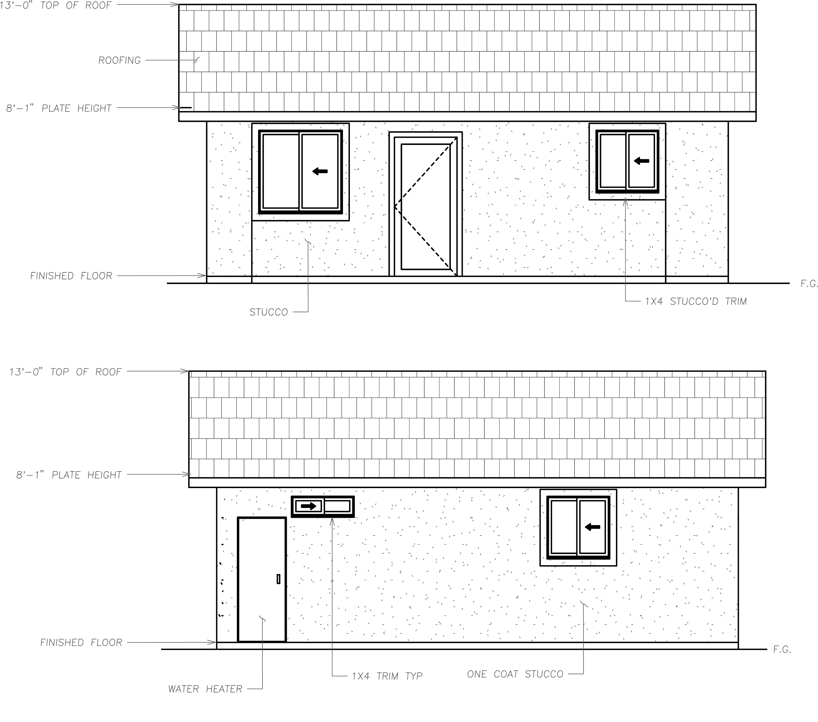
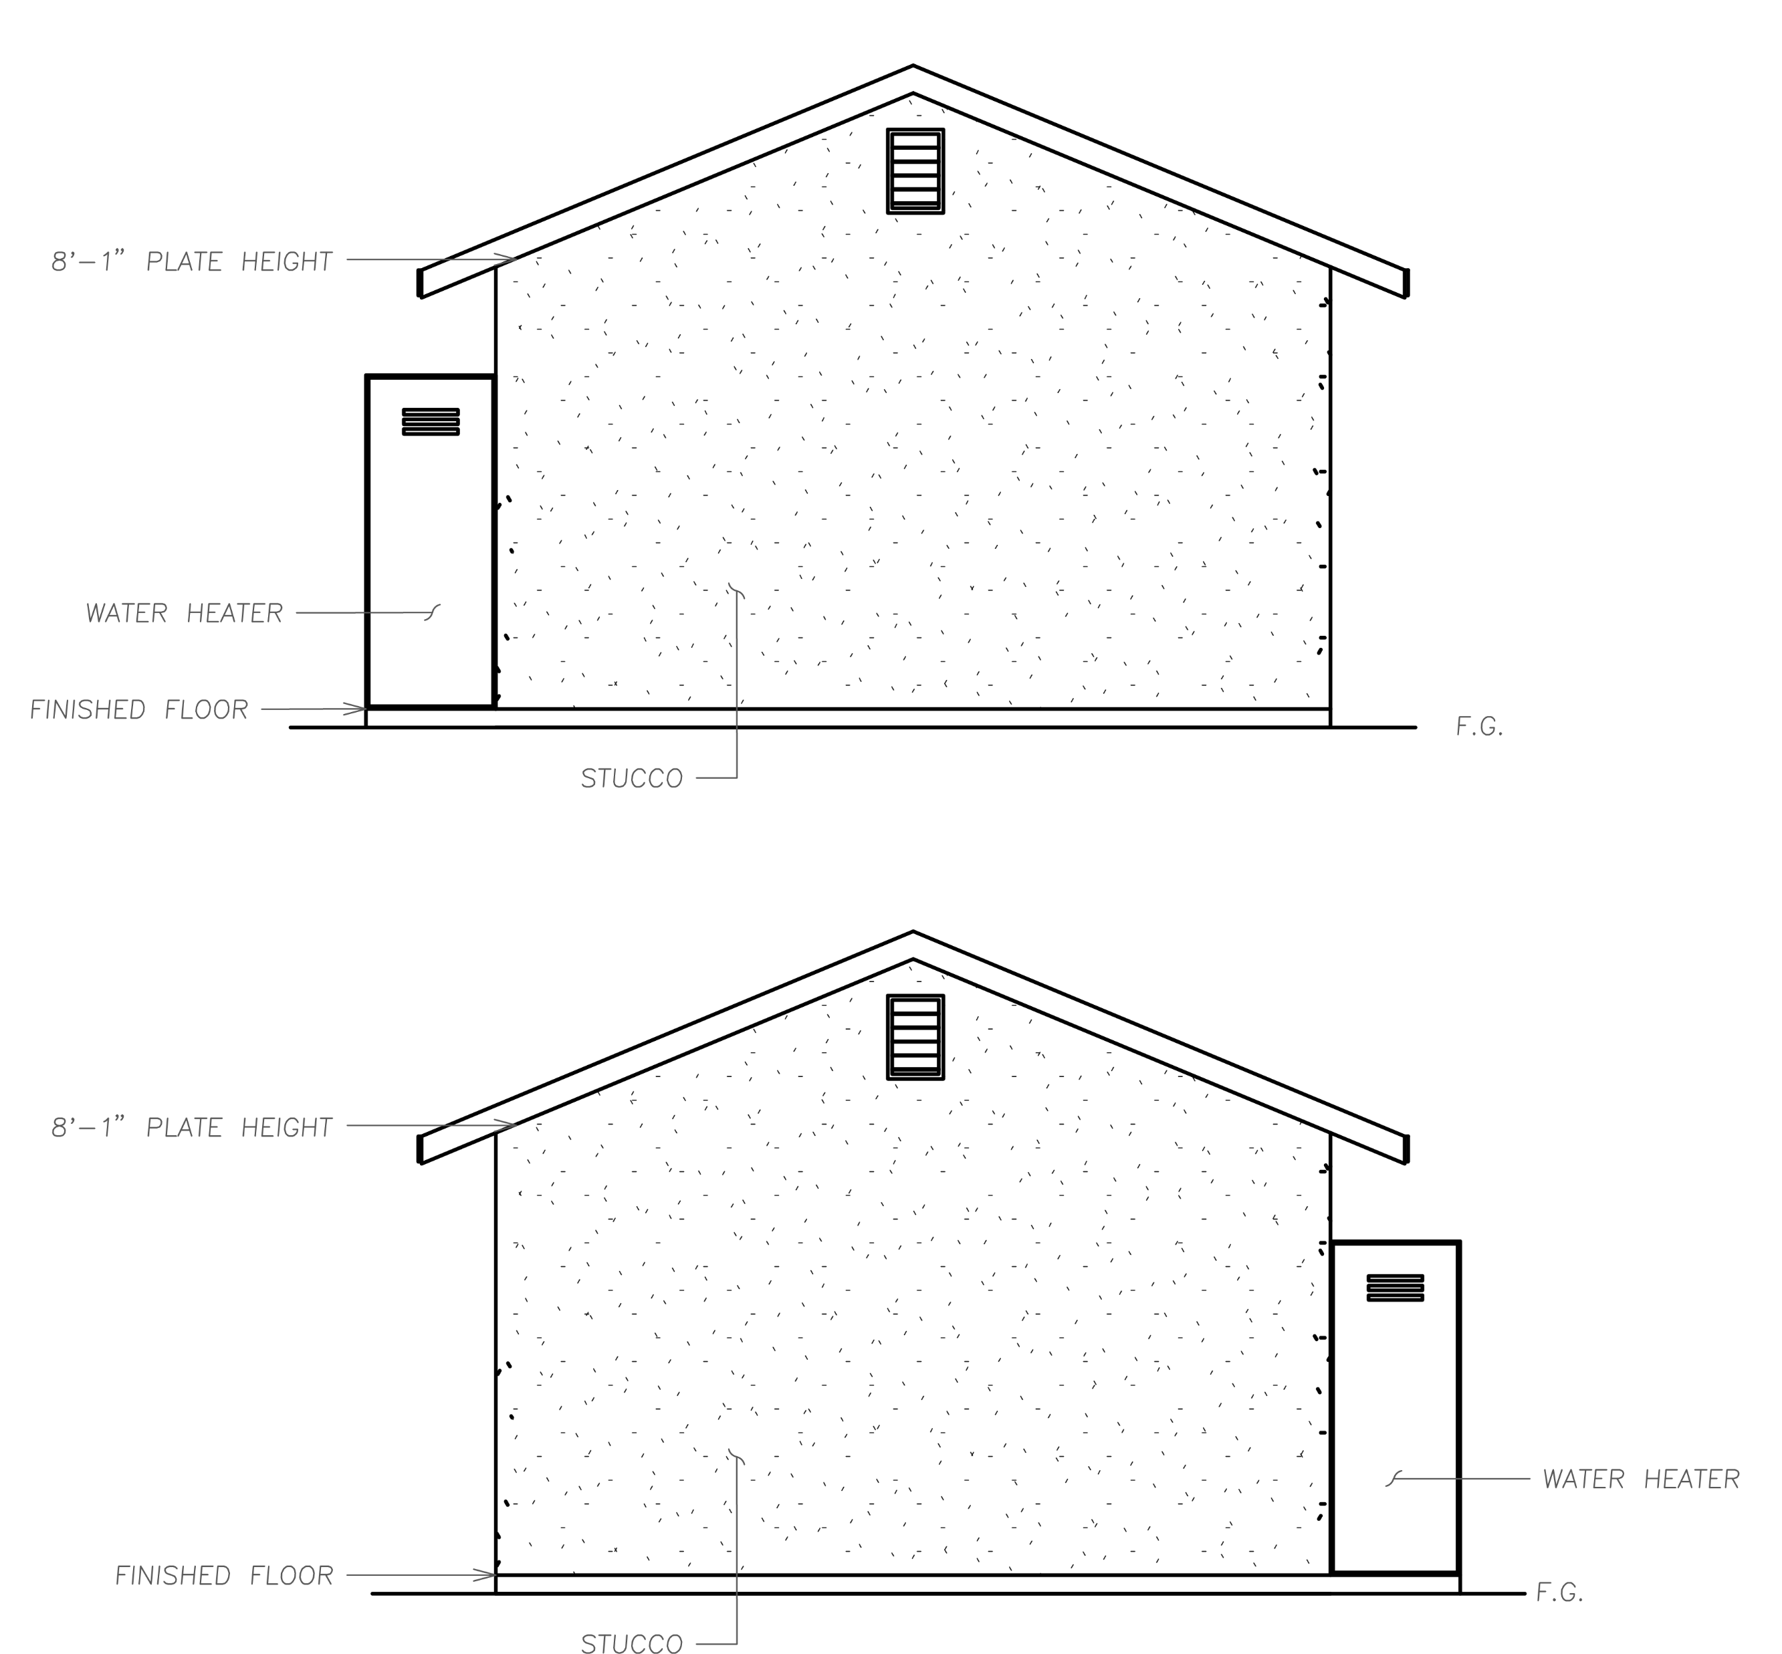
- - - - - ELEVATIONS - - - - -
ELEVATION A
SPANISH/MEDITERRANIAN
375 Square Foot Elevation:
PAGE 16

Slide 19
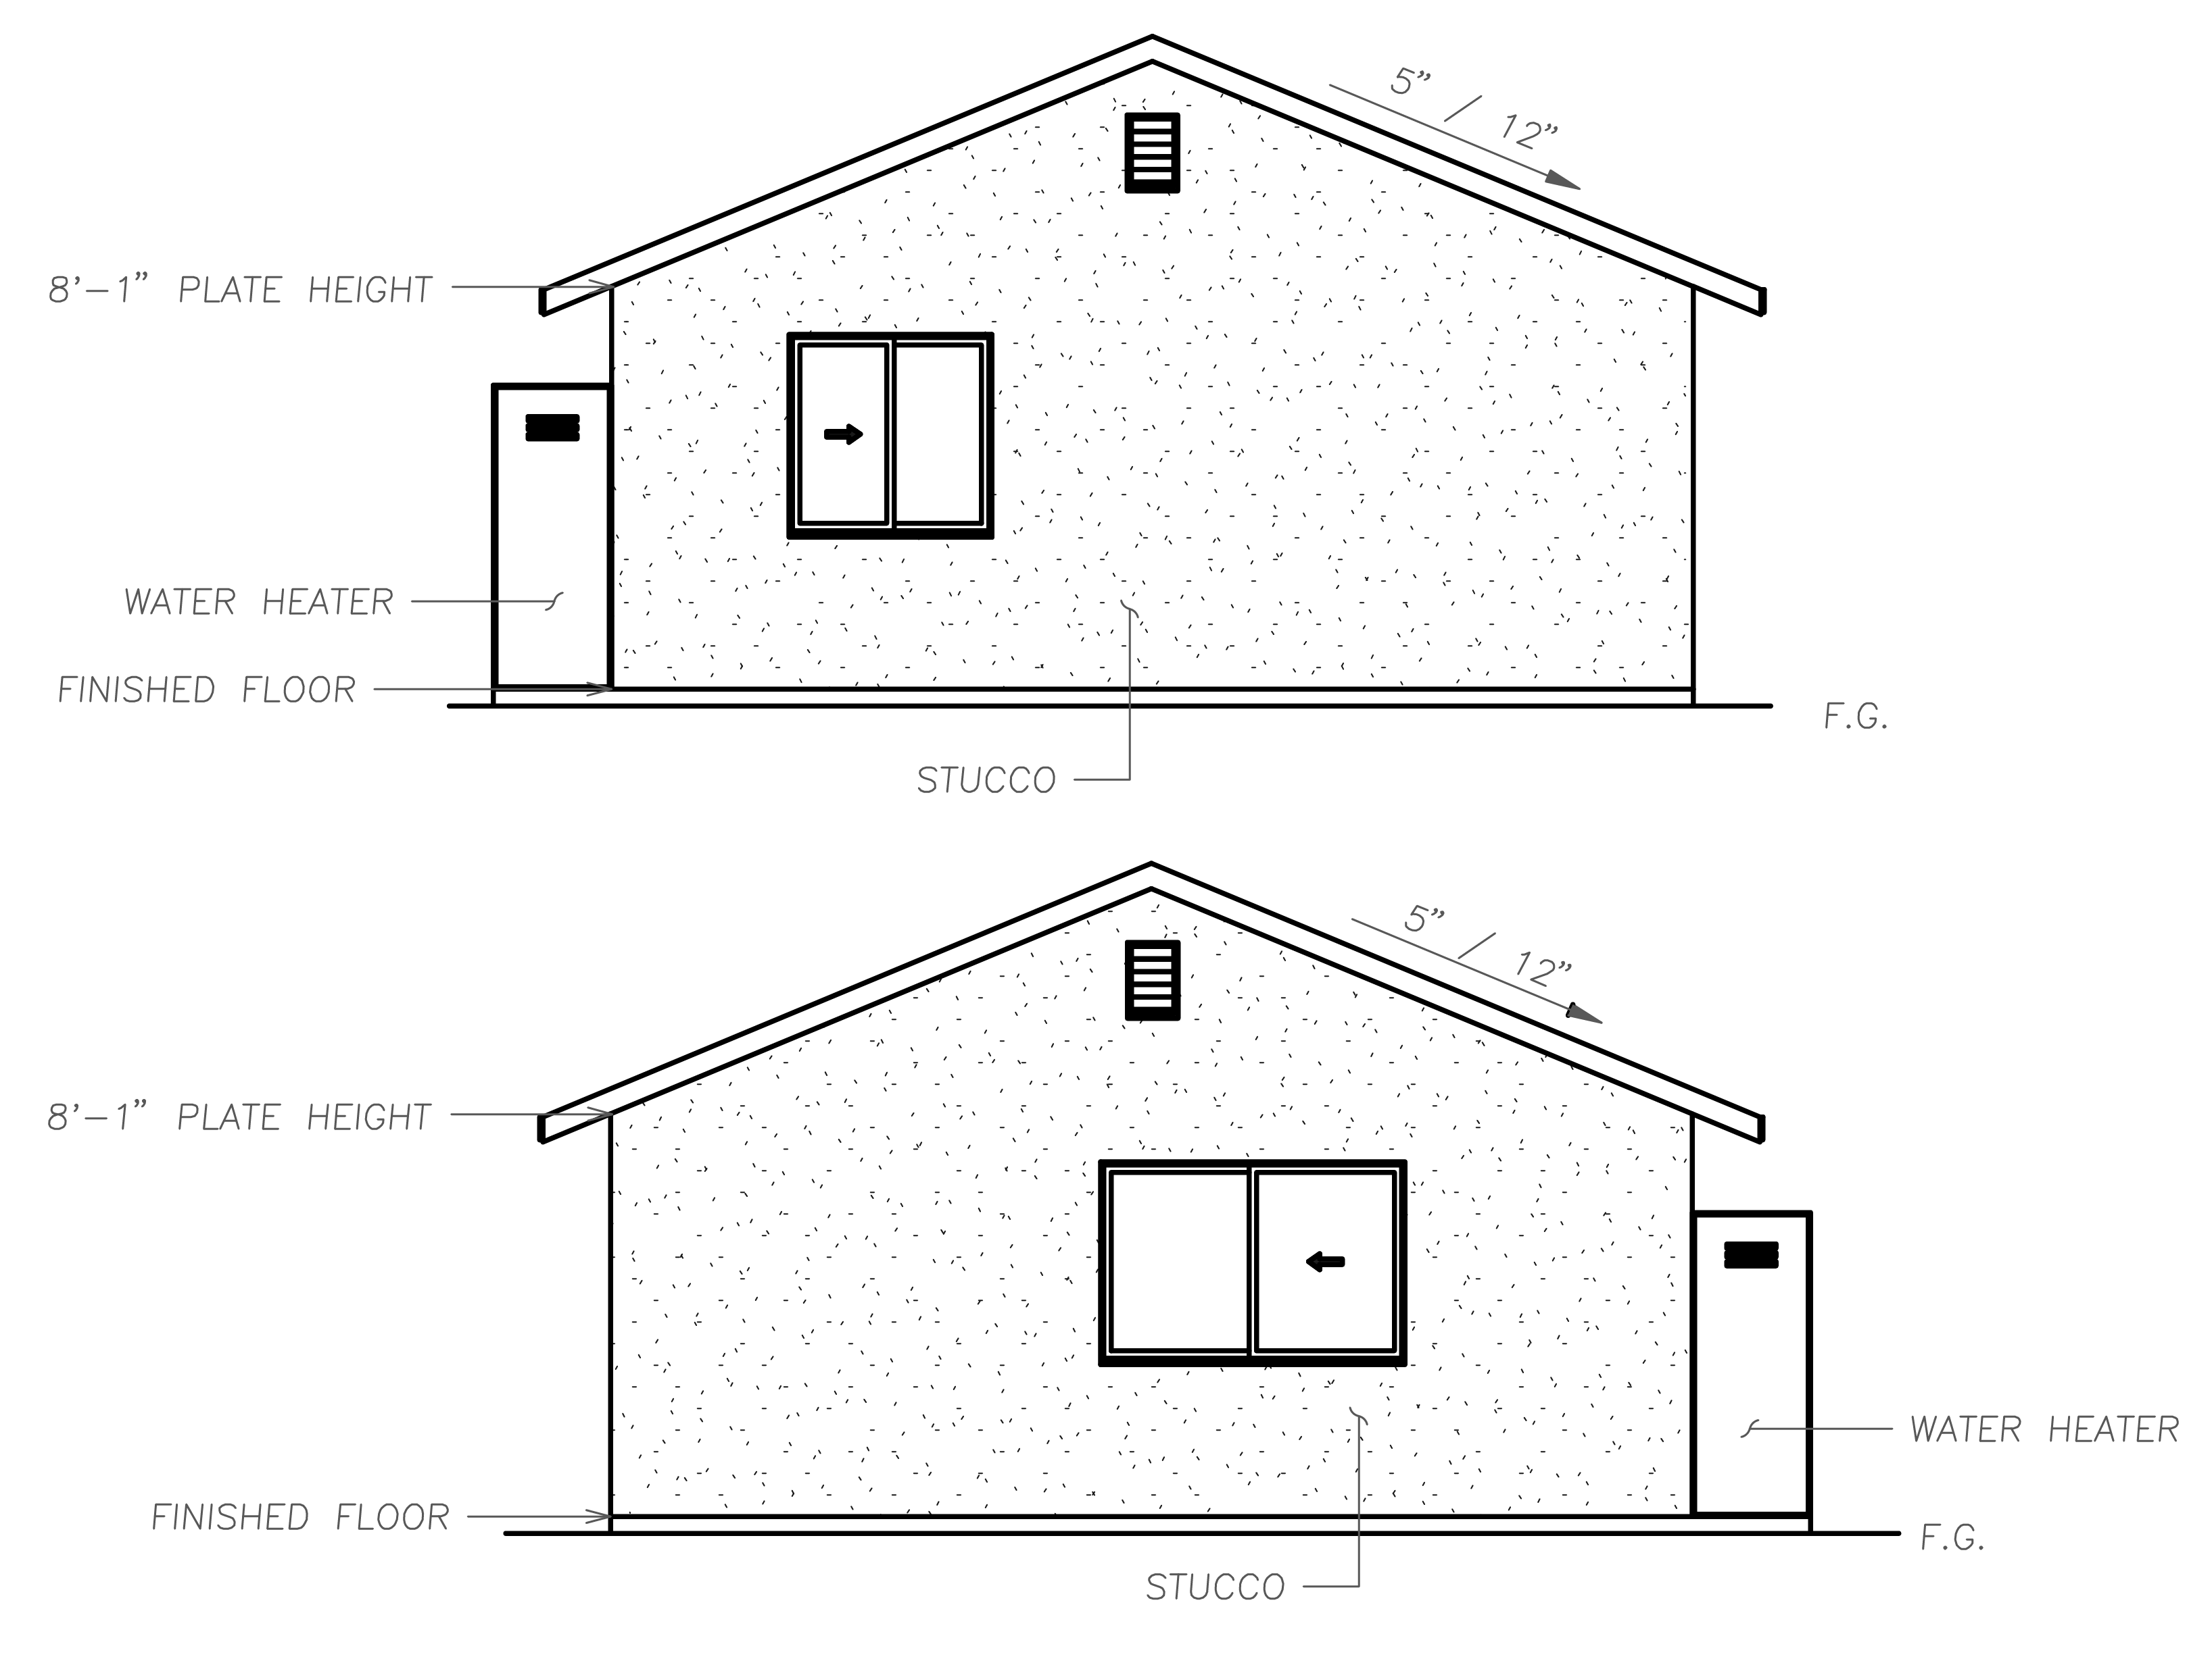
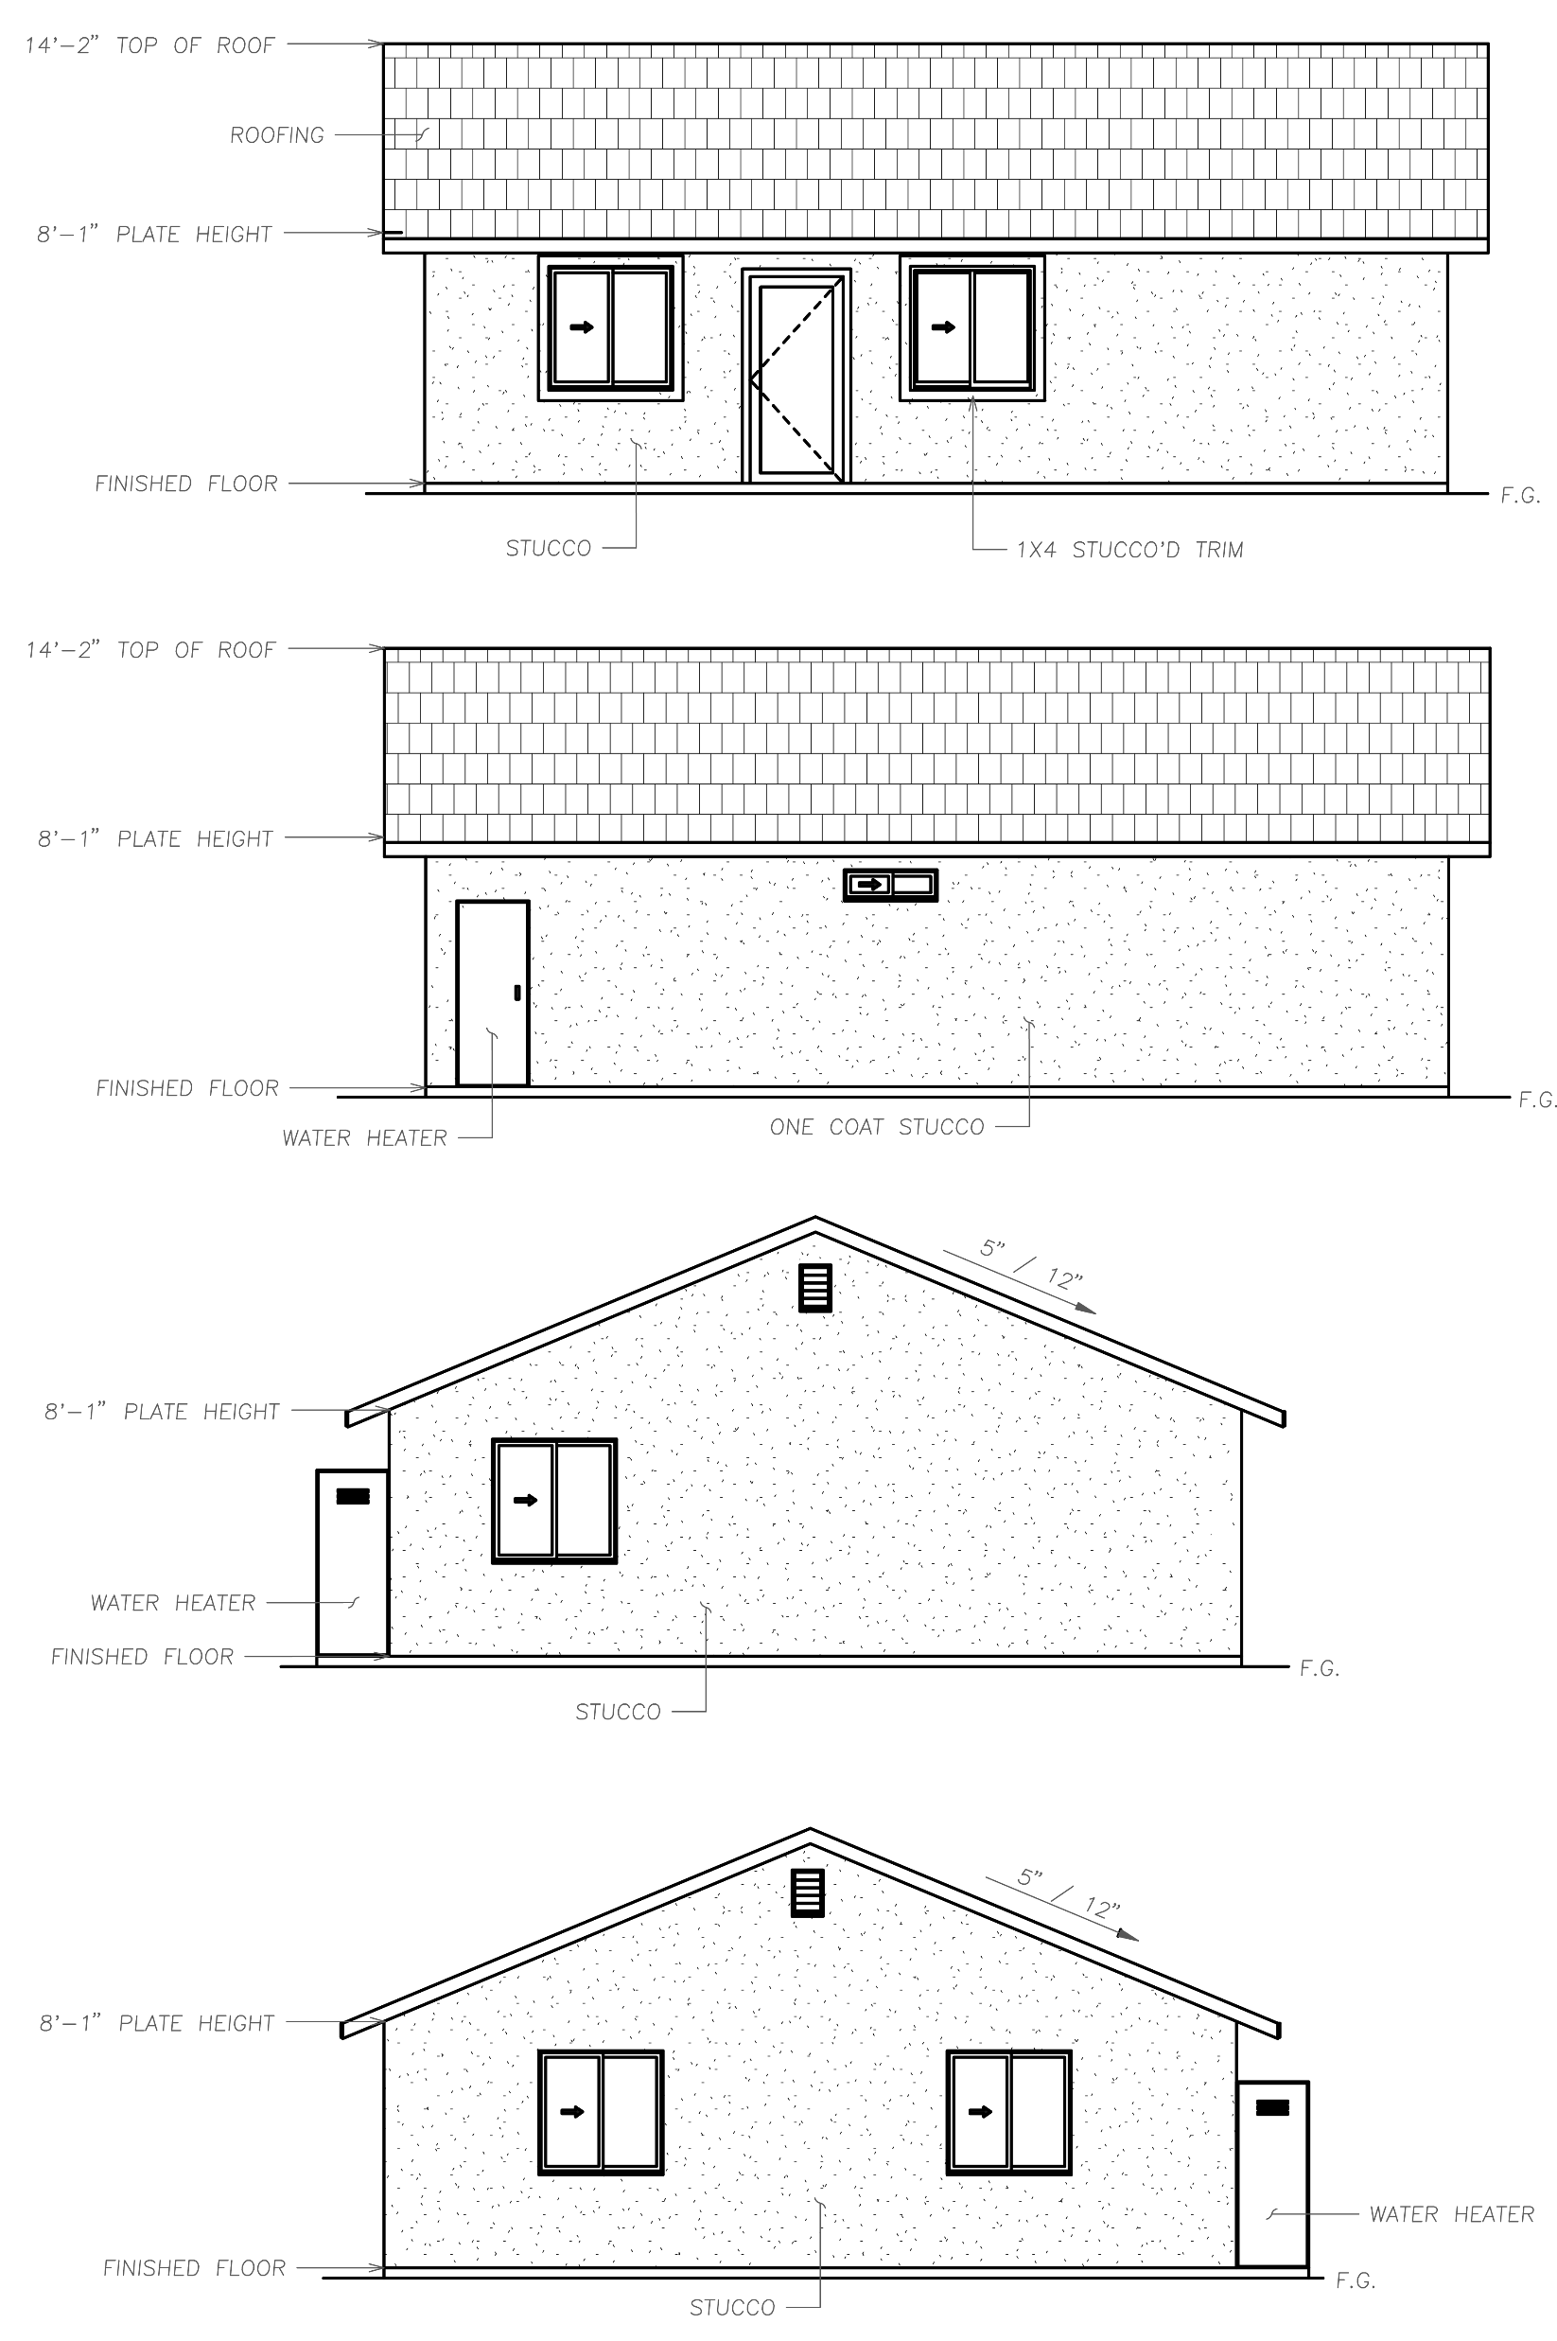
550 Square Foot Elevation:
743 Square Foot Elevation:
908 Square Foot Elevation:
PAGE 17

Slide 20
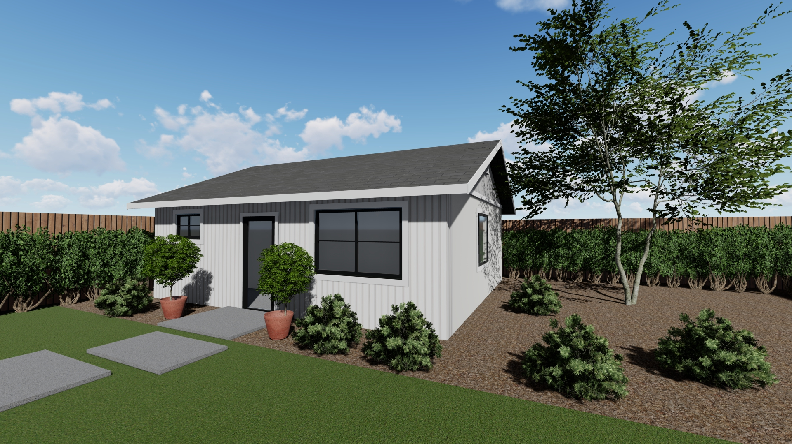
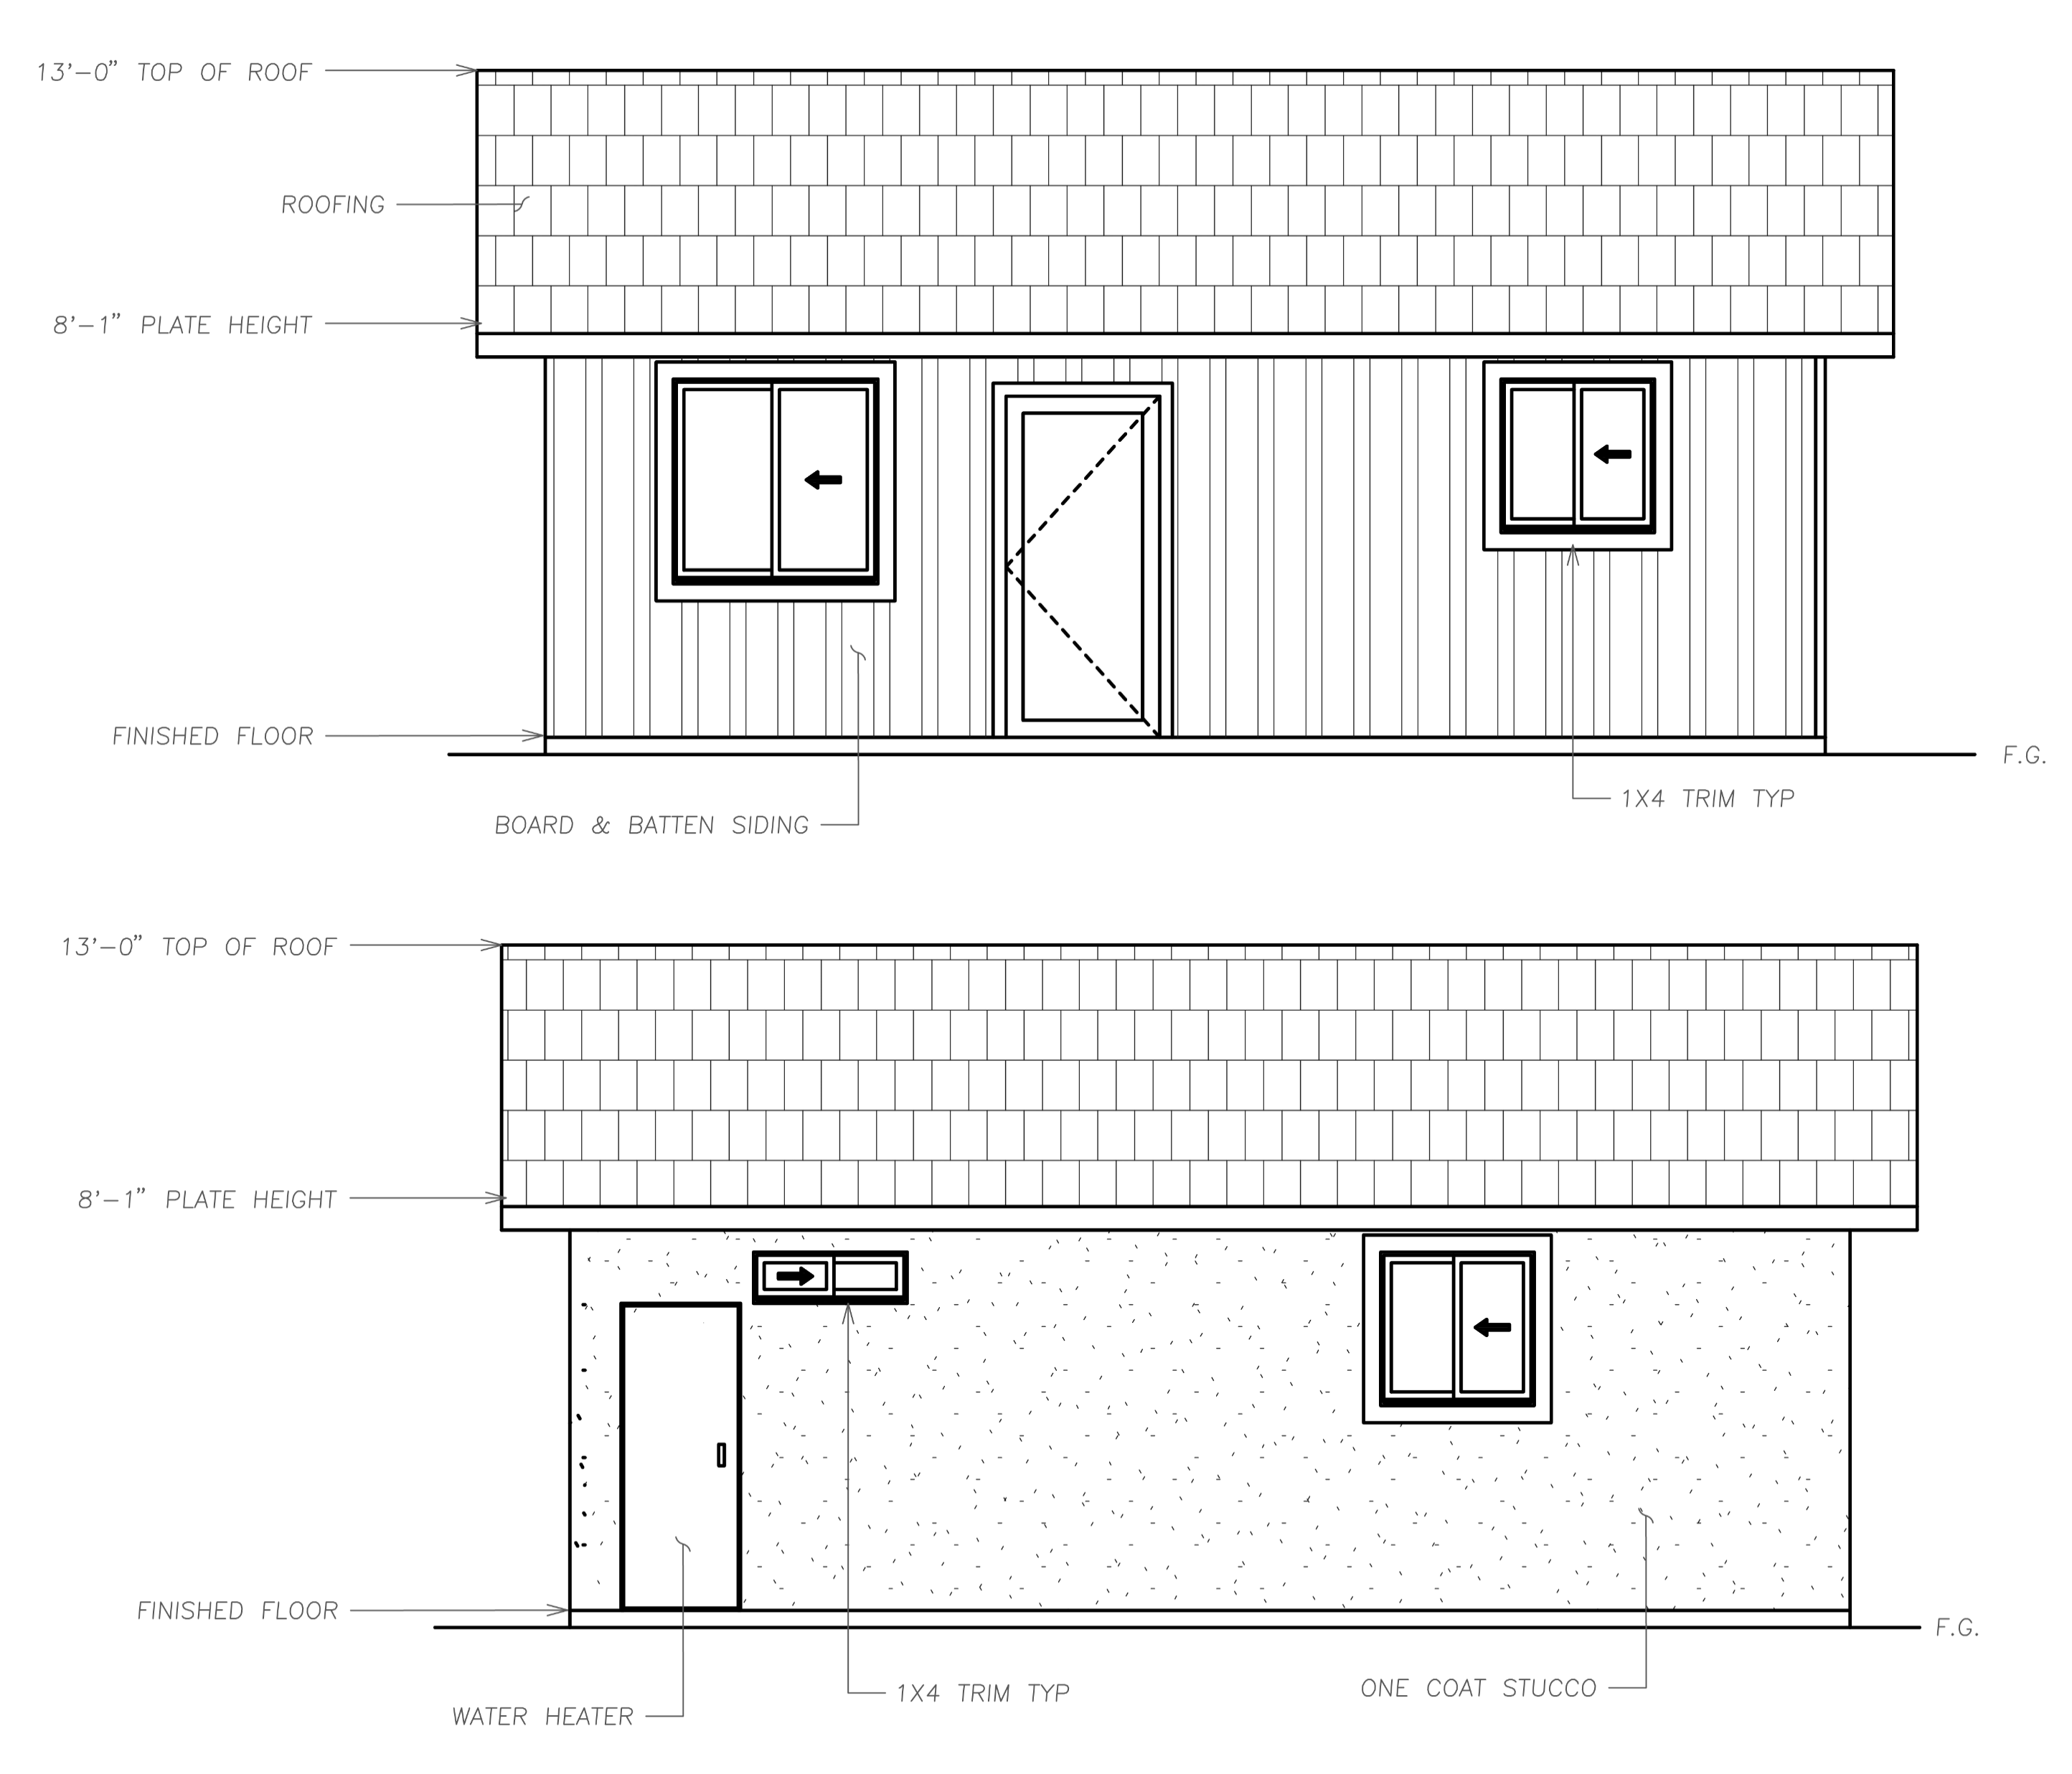
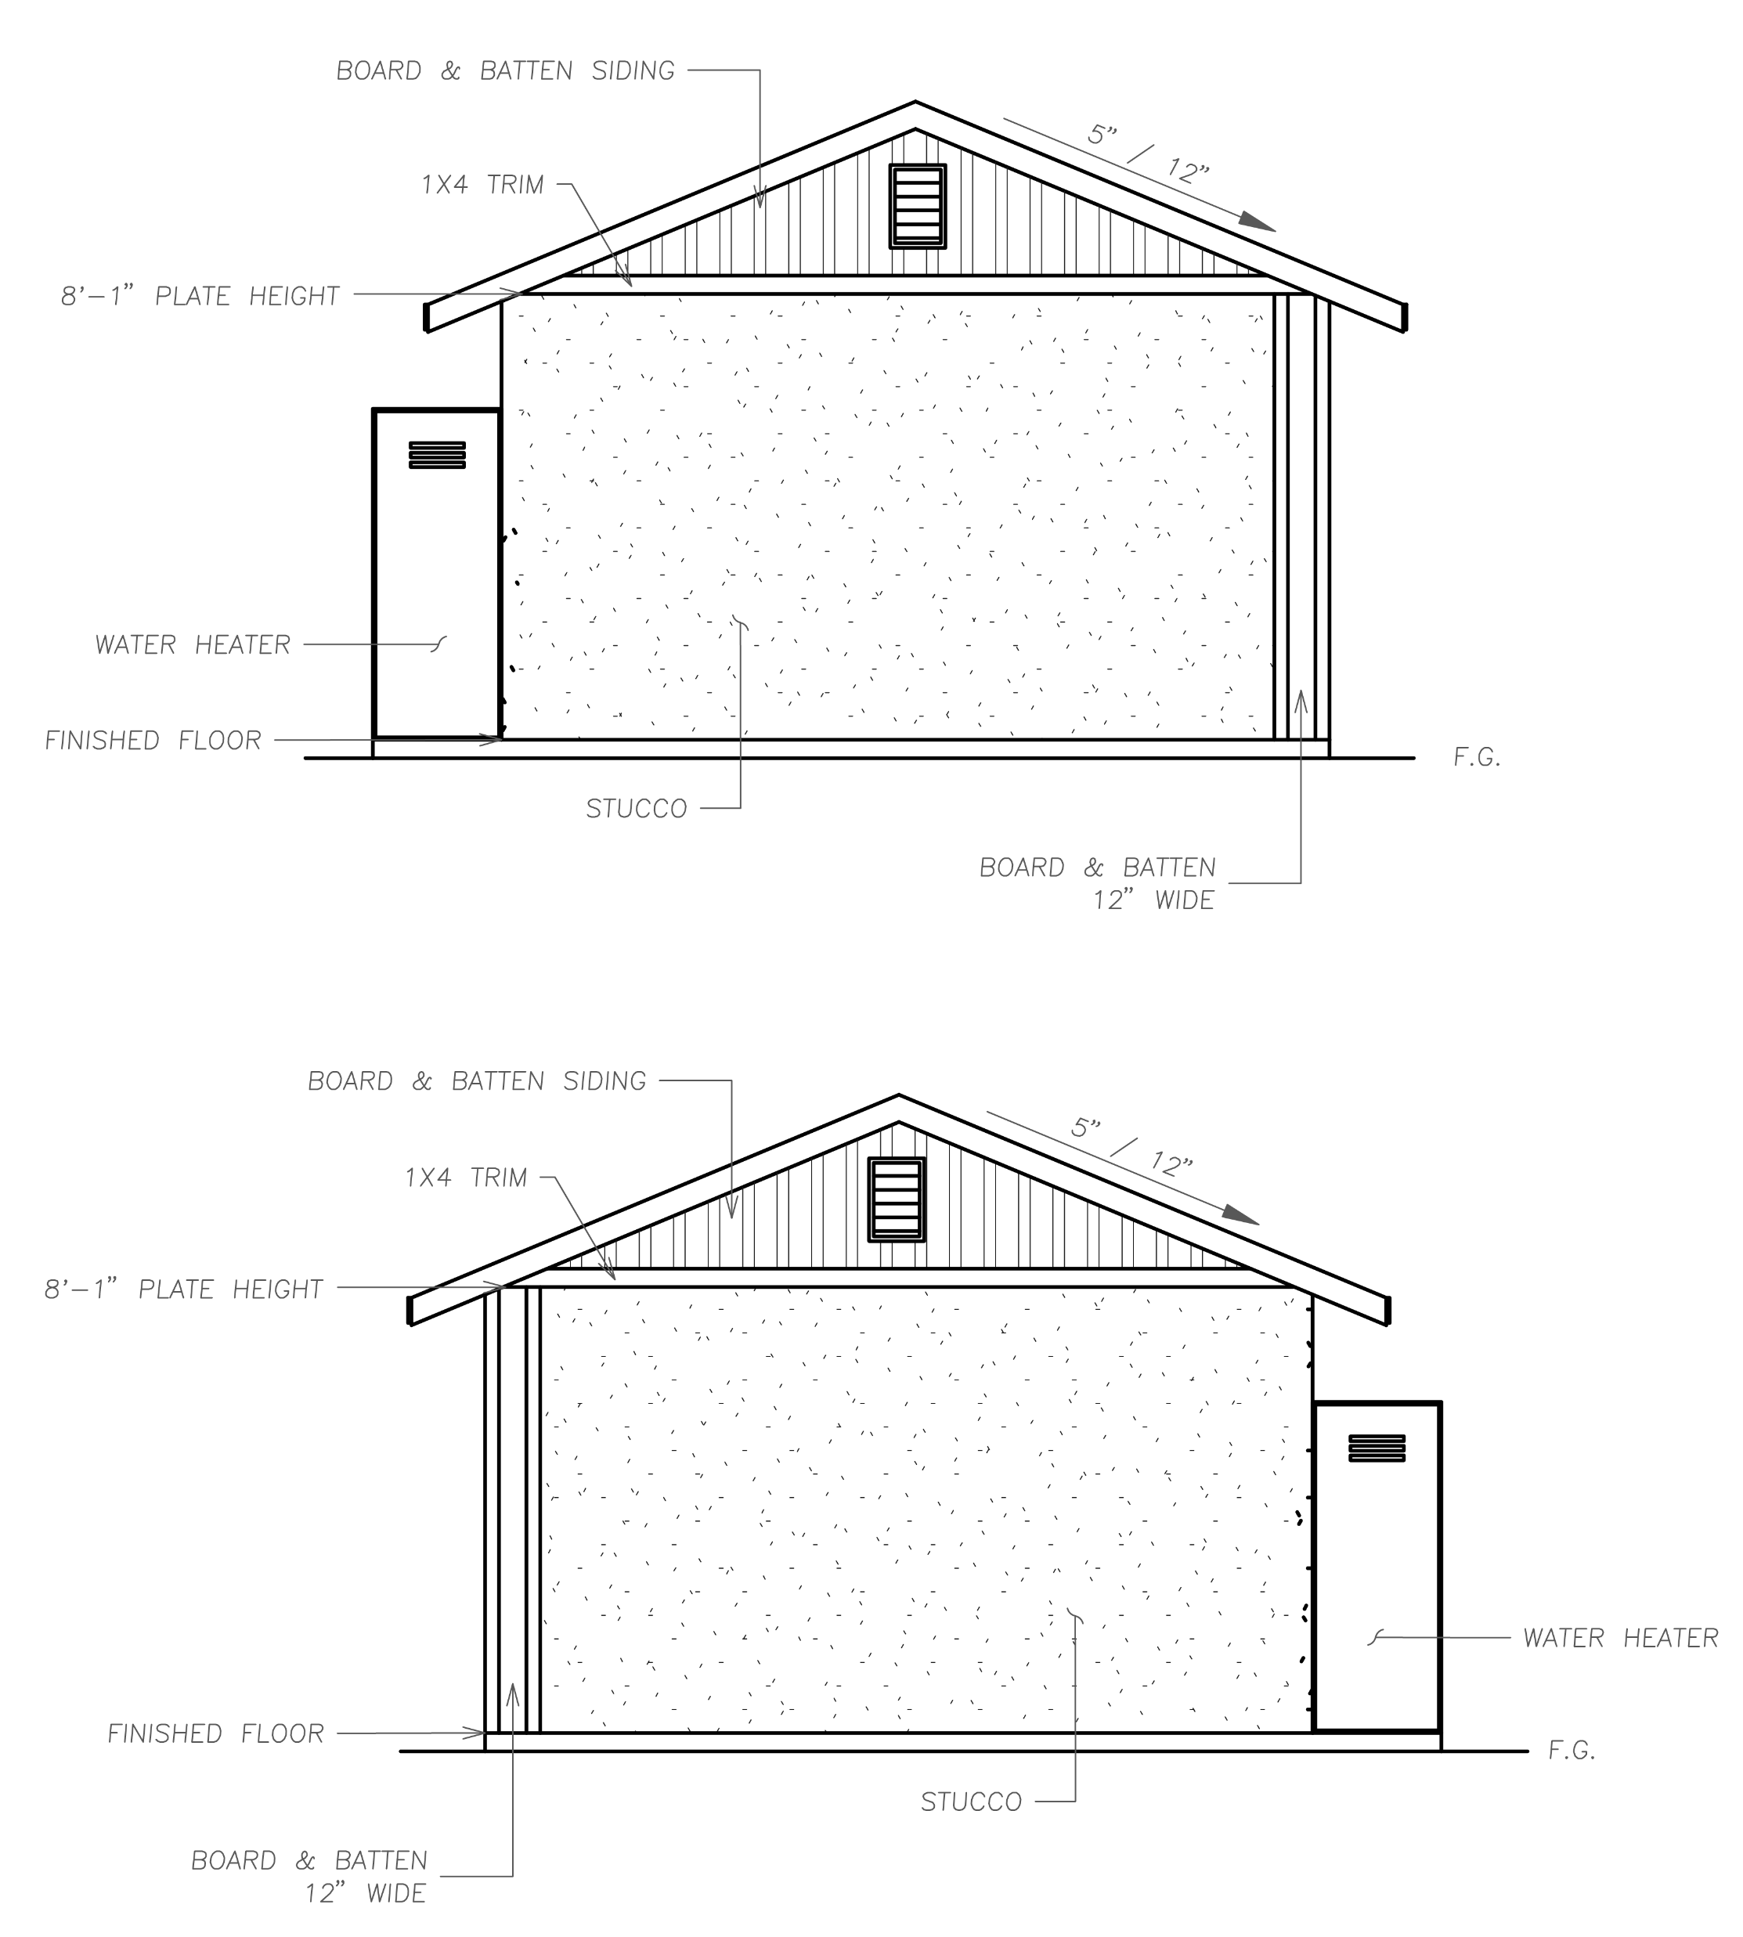
ELEVATION B
MODERN FARMHOUSE
375 Square Foot Elevation:
PAGE 18

Slide 21
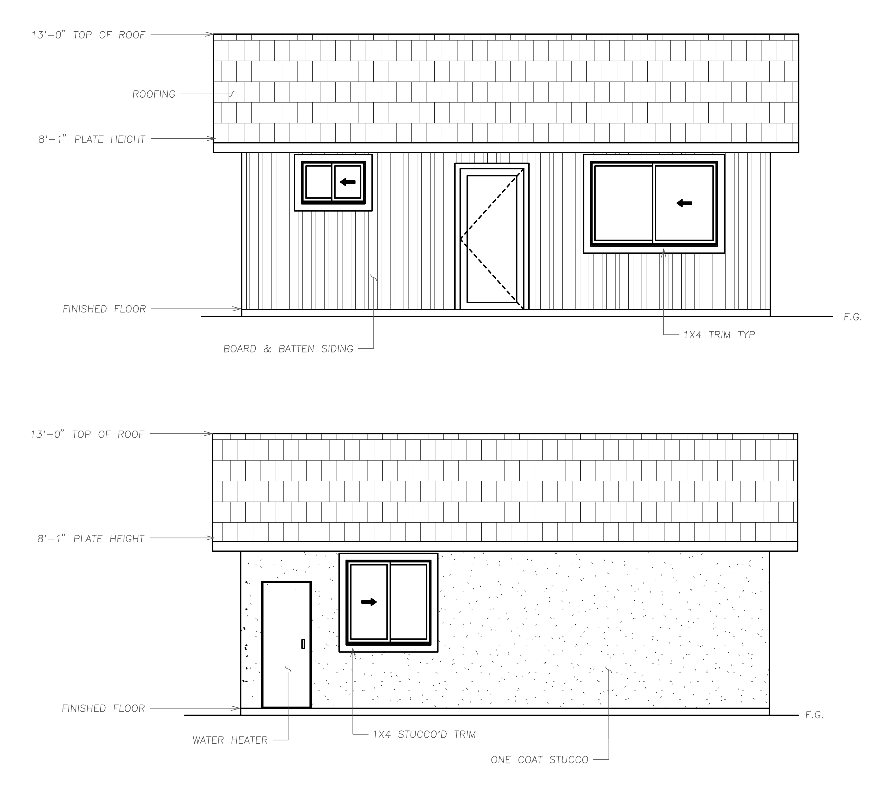
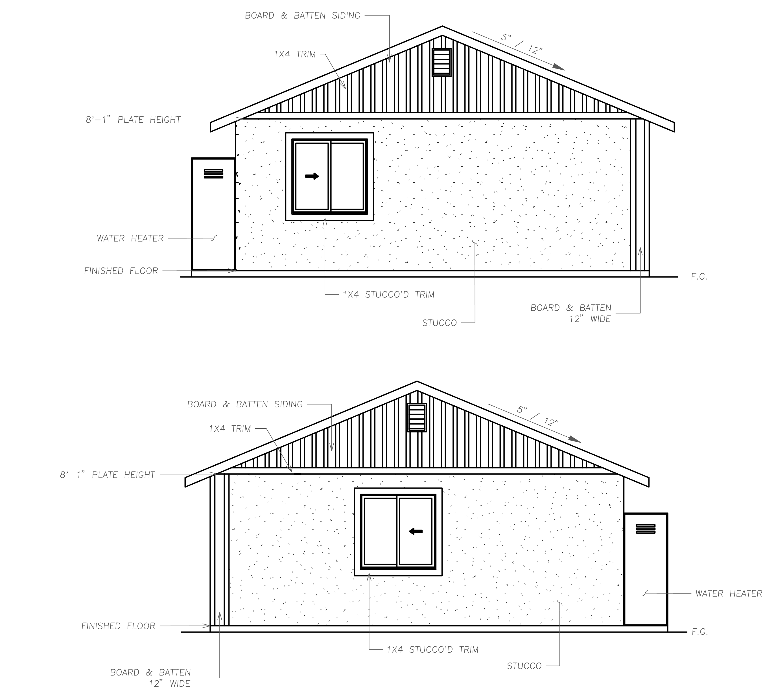
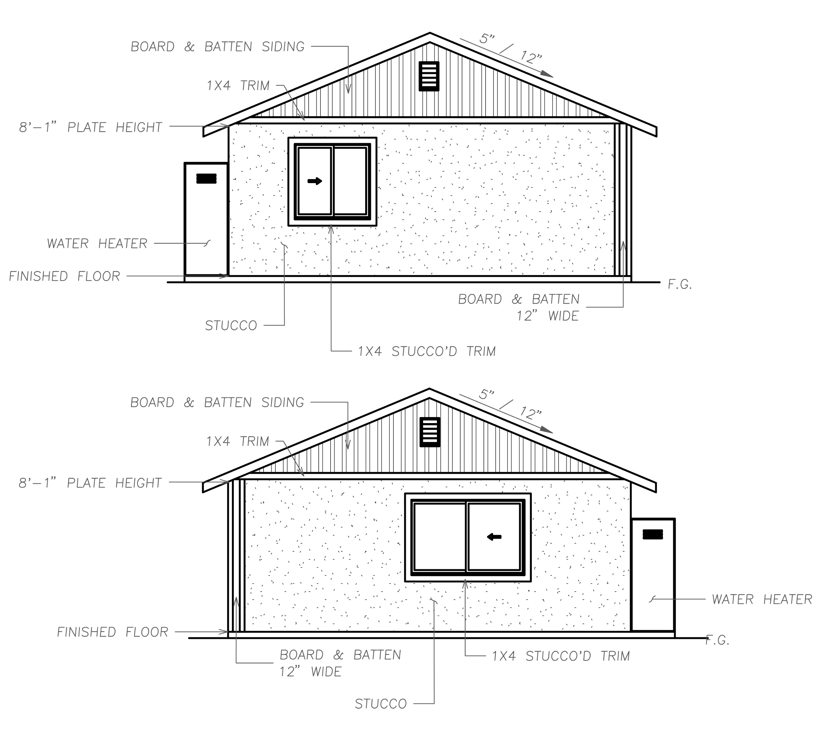
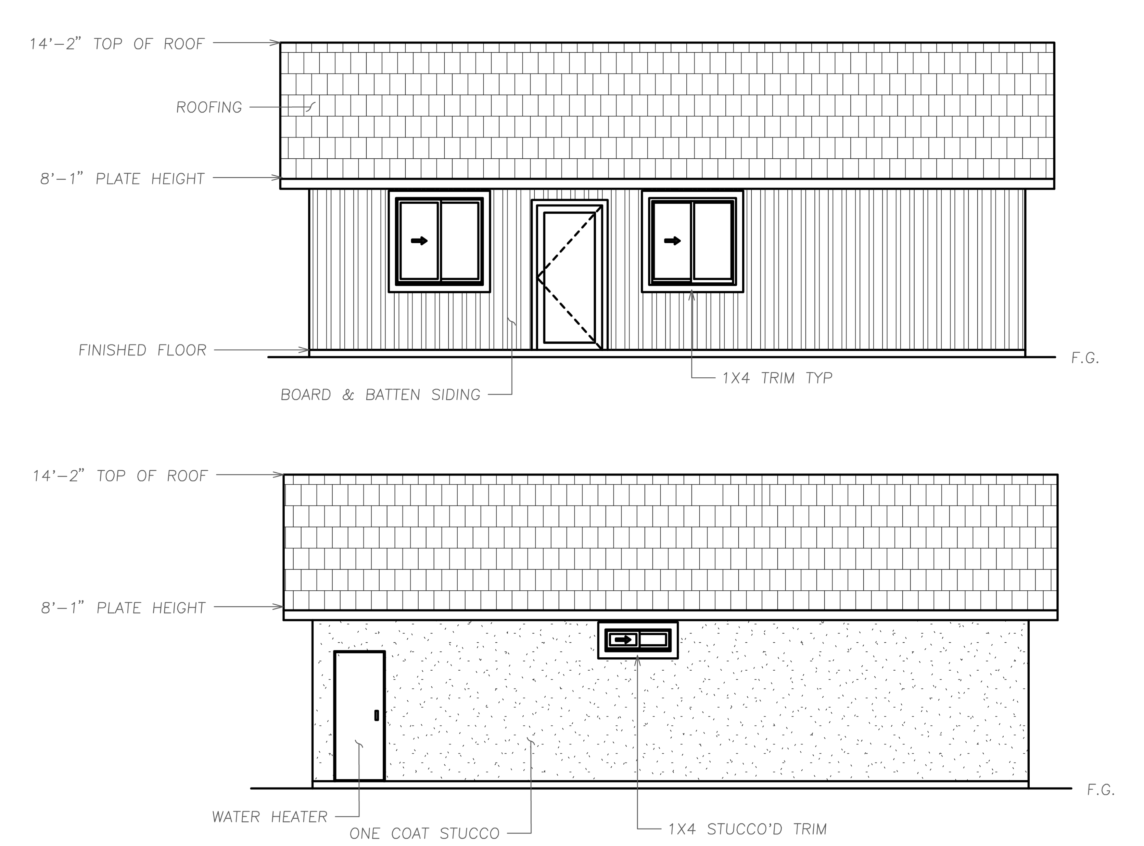
550 Square Foot Elevation:
743 Square Foot Elevation:
908 Square Foot Elevation:
PAGE 19

Slide 22
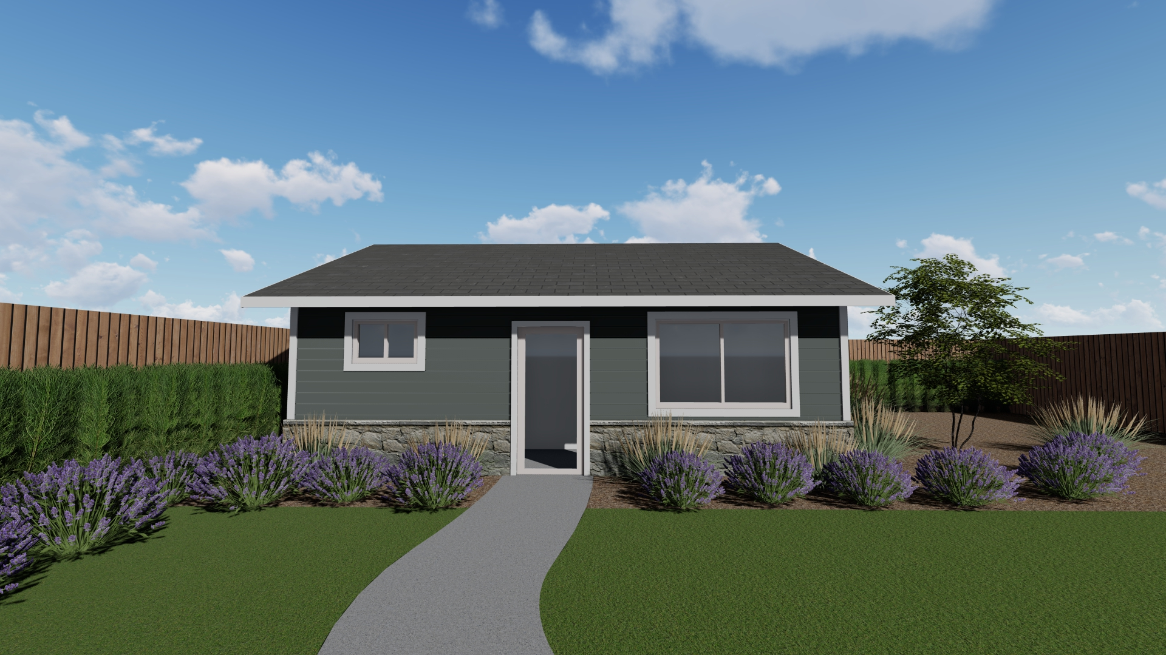
ELEVATION C
CRAFTSMAN/BUNGALOW
375 Square Foot Elevation:
PAGE 20

Slide 23
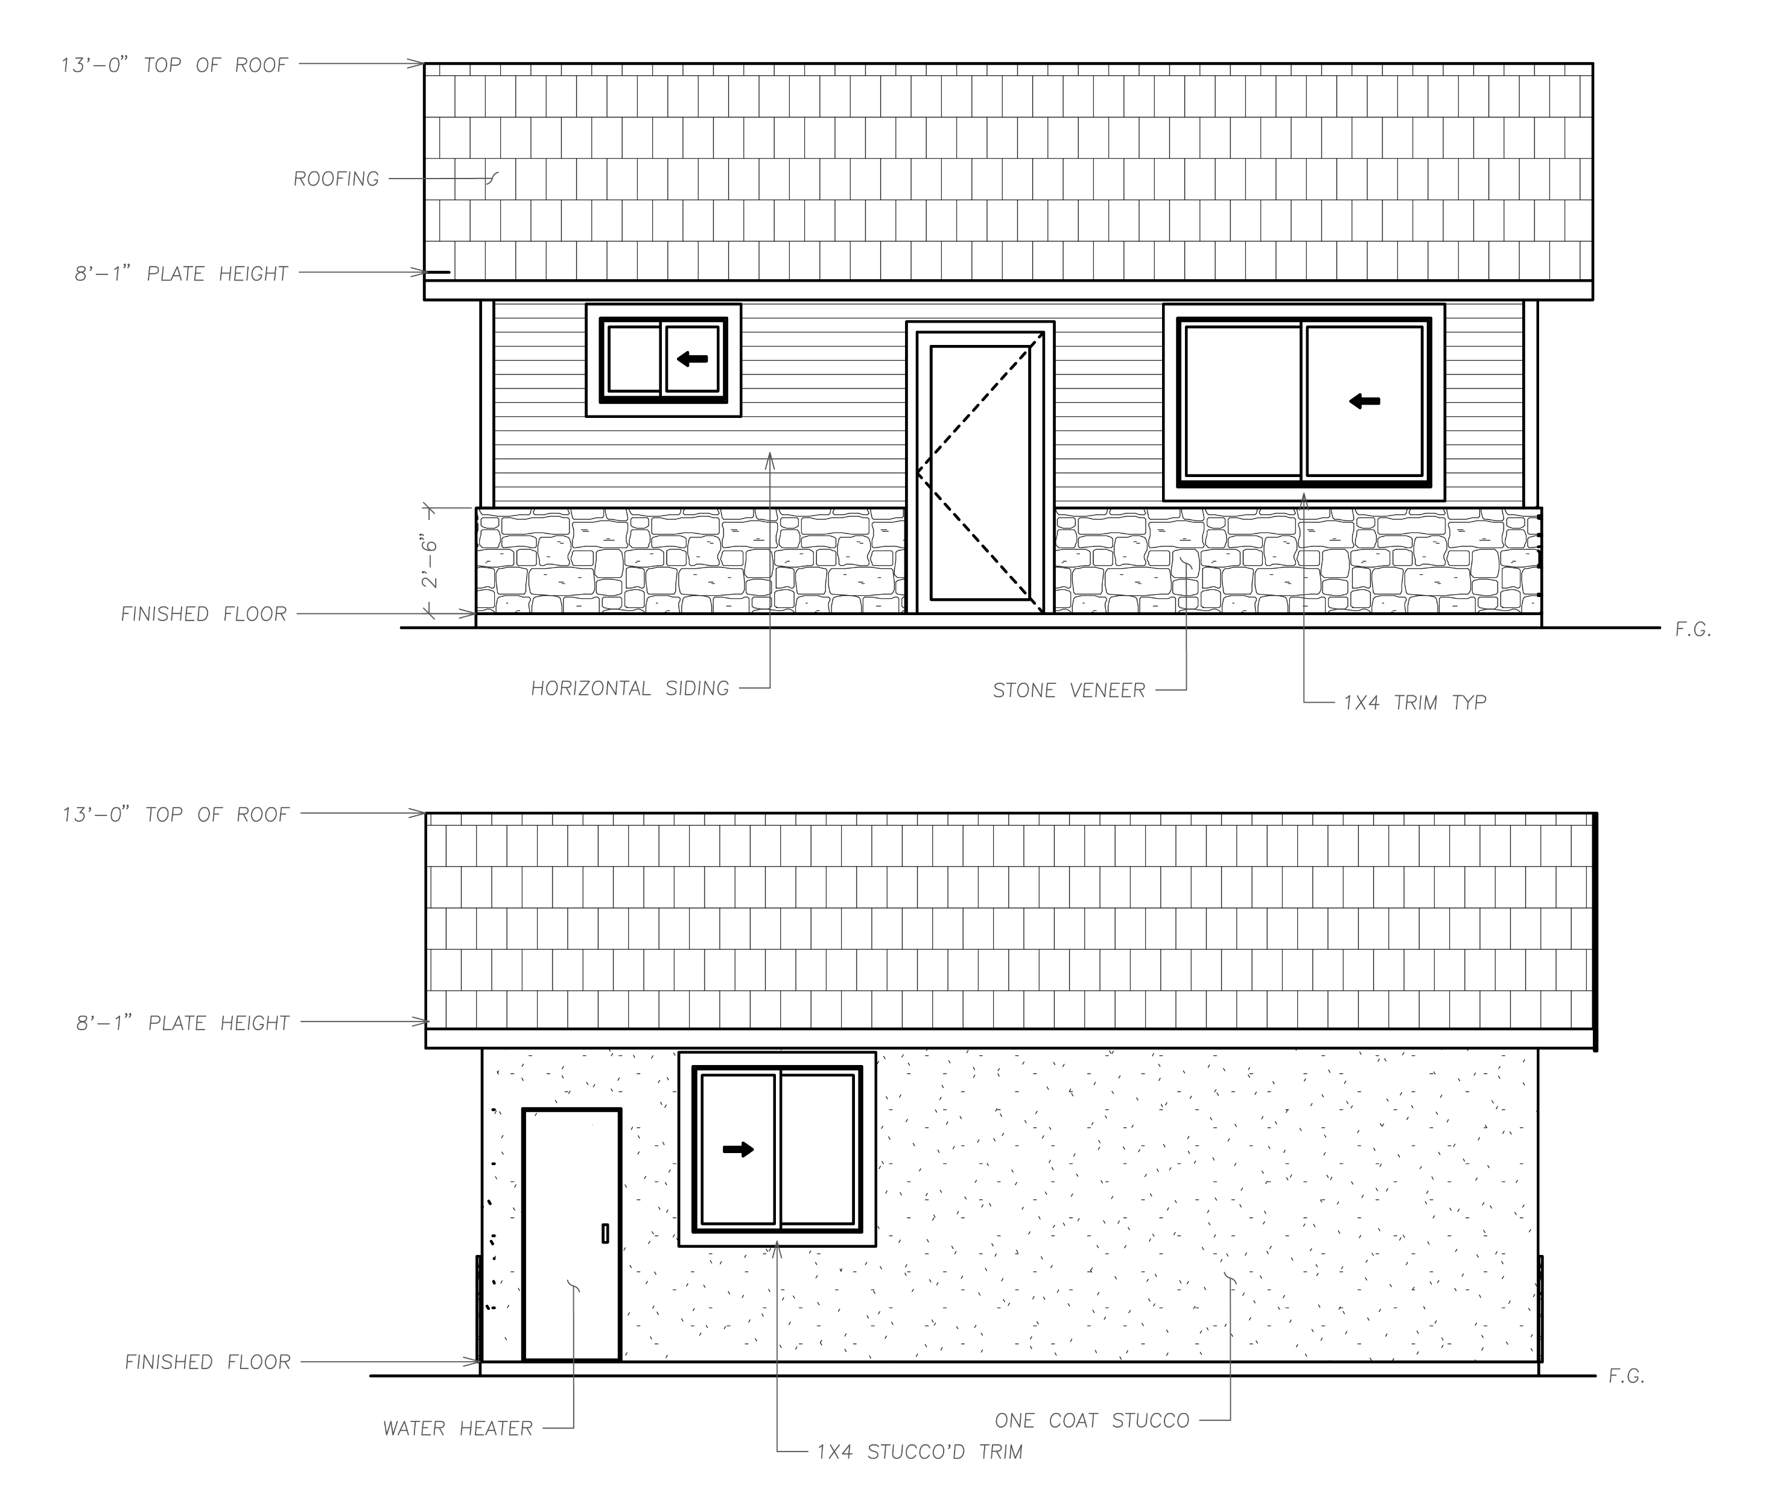
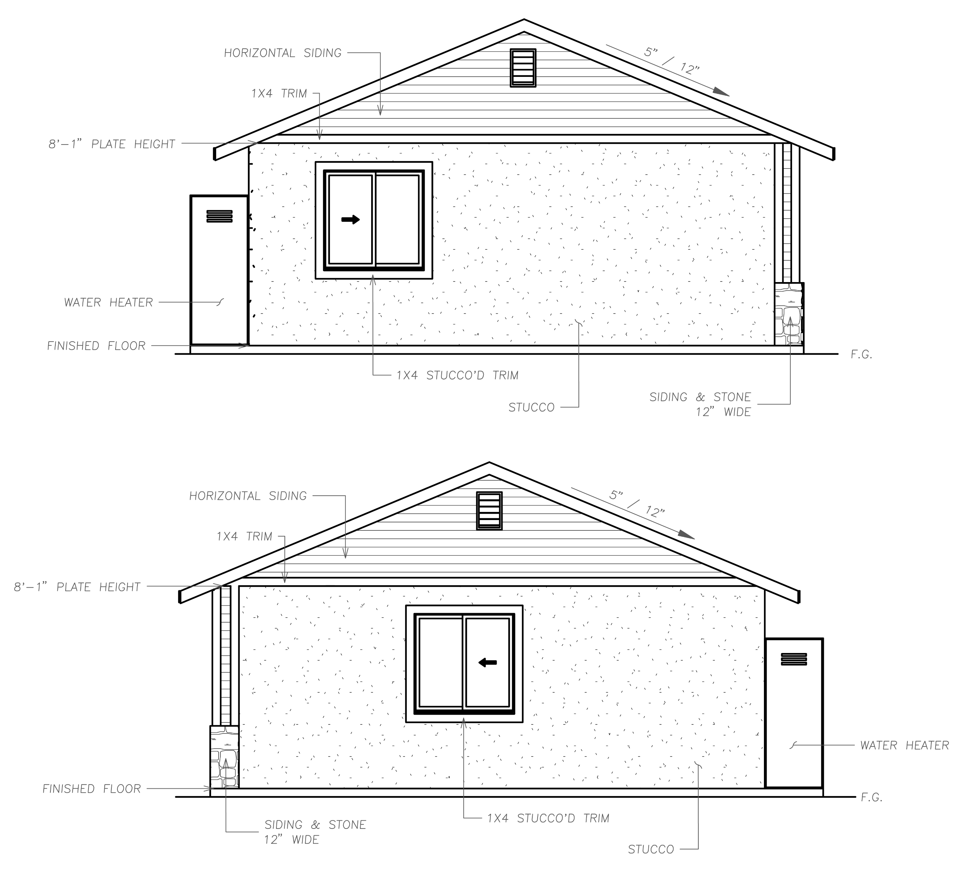
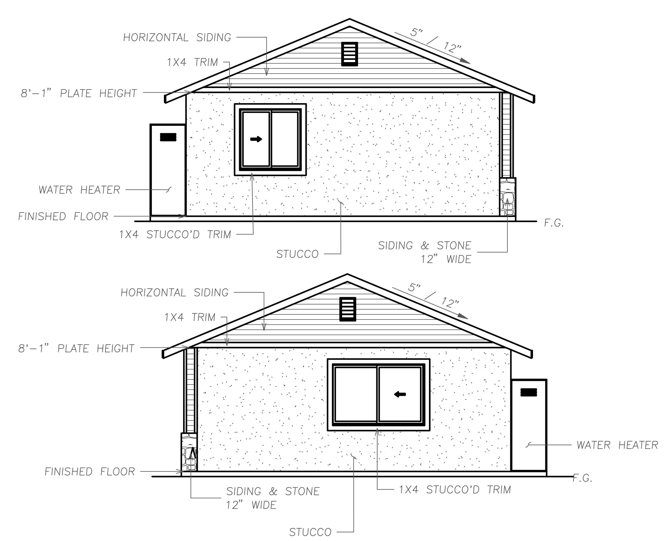
550 Square Foot Elevation:
743 Square Foot Elevation:
908 Square Foot Elevation:
PAGE 21

Slide 24
5.
SECTION 5.
RESOURCES, CONTACTS AND FURTHER READING
- - - - - FREQUENTLY ASKED QUESTIONS - - - - -
Where are ADUs allowed? Page 3
What types of ADUs are allowed? Page 2
How many ADUs can I build on my property? Page 6
What are the site requirements for my property? Page 6
What are the size limitations for ADUs? Page 6
- - - - - RESOURCES, CONTACTS, AND FURTHER READING - - - - -
Resources
Lemoore Zoning Ordinance Code – https://codelibrary.amlegal.com/codes/lemooreca/latest/lemoore_ca/0-0-0-7229
California Residential Code - https://www.dgs.ca.gov/BSC/Codes
CalGreen Code - https://www.dgs.ca.gov/BSC/CALGreen
City of Lemoore Community Development Department- https://lemoore.com/departments/community-development#/
Contacts
City of Lemoore Planning Division - (559) 924-6744, ext. 740
City of Lemoore Building Division – (559) 924-6744 ext. 730
Further Reading
California Department of Housing and Community Development – ADU Handbook (Updated January 2025) - https://www.hcd.ca.gov/sites/default/files/docs/policy-and-research/ADUHandbookUpdate.pdf
PAGE 22

Slide 25
City of Lemoore
711 W. Cinnamon Drive
Lemoore, CA 93245
(559) 924-6744, ext. 730
https://lemoore.com/

